Slide 1
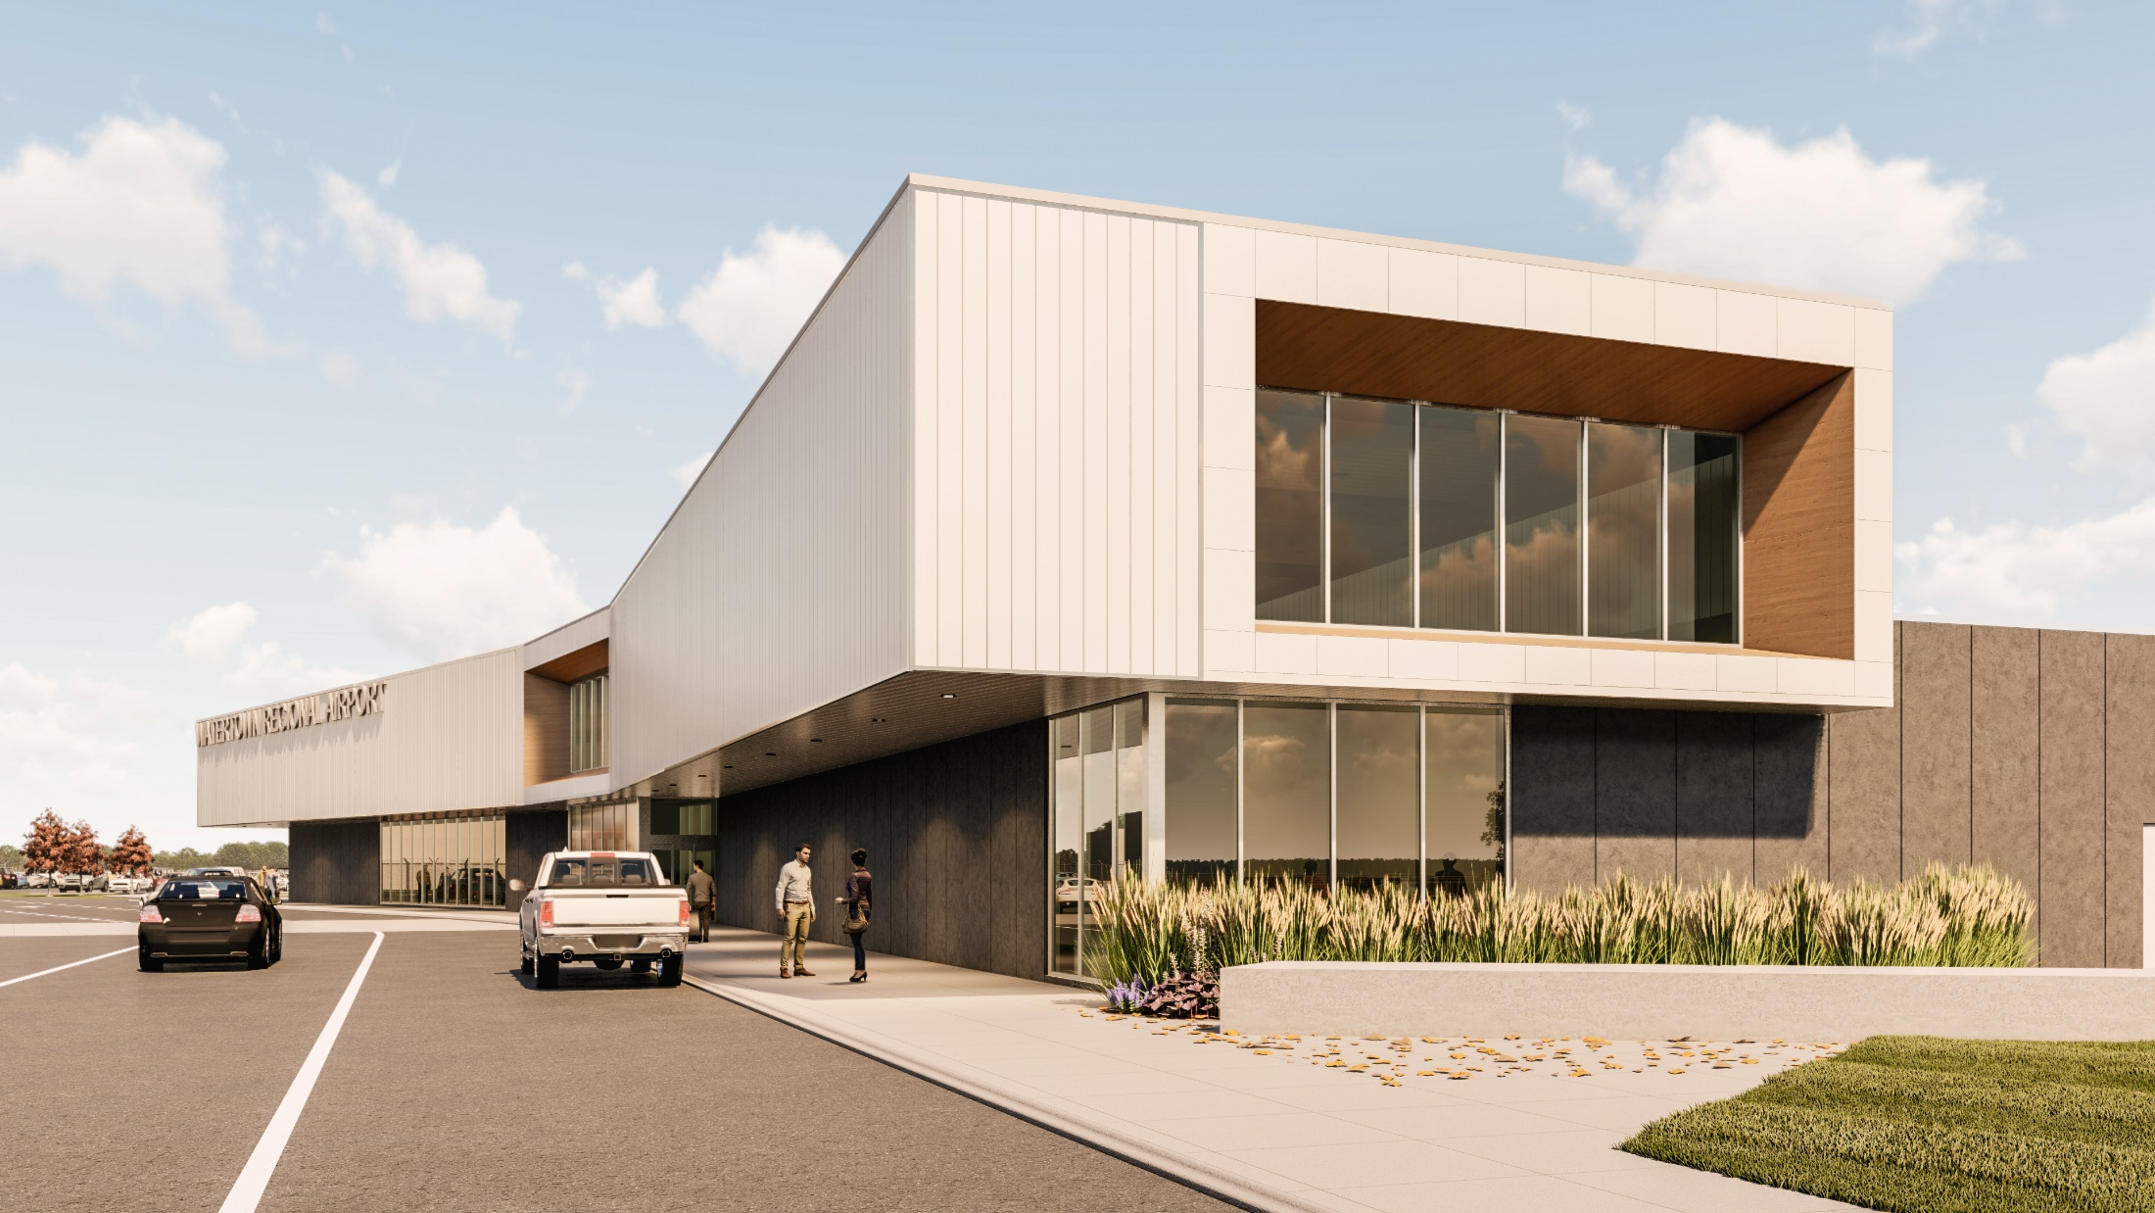
Watertown regional airport (aty)
SD Airport Conference
April 2022

Slide 2
ATY Terminal Planning, Design and Construction
Overview
Concept Budget Report
Design
Construction

Slide 3
SD Aviation Commission – ATY Overview
Consultants –
Helms and Associates (ABR)
Mead & Hunt (MSP)
CO-OP Architecture (ABR/ATY/FSD/RAP)
Process – Concept Budget Report
Provide Concept Budget Report for future Design and Const. – Published June 2019
Received Discretionary Funding from the second round of the Supplemental Appropriation
Design – December 2019 – July 2020
Construction – September 2020 – July 2022

Slide 4
SD Aviation Commission – CBR
Inventory/Existing Facility -
Programming – Space Allocation
Alternatives – Terminal Area
Schedule/Budget –

Slide 5
Forecasts

Slide 6
Inventory – Existing Conditions

Slide 7
Inventory – Existing Terminal
Undersized TSA security checkpoint and queuing space
Insufficient passenger gate seating
Aircraft parking apron size insufficient in accordance with concourse growth
Outdated building systems
No passenger boarding bridges
Lack of post-secure, full-service concessions
Insufficient TSA baggage screening area
Insufficient baggage makeup area
Insufficient airline ticket counters and kiosks
Insufficient ticketing queuing and non-secure circulation space
Insufficient airline ticket office (ATO) space
Undersized baggage claim area and no baggage claim devices
No rental car or adequate space to lease a rental car to any potential provider
Lack of conference/meeting/training space for airport tenants
Dated terminal building aesthetics, both interior and exterior
Absence of public (non-secure) viewing and waiting space (meeters and greeters)
Undersized airport administration area

Slide 8
Inventory – Existing Terminal
Existing Floor Plan

Slide 9
Inventory – Existing Terminal
TSA Queue, Exiting Lane, Ticketing and Bag Claim

Slide 10
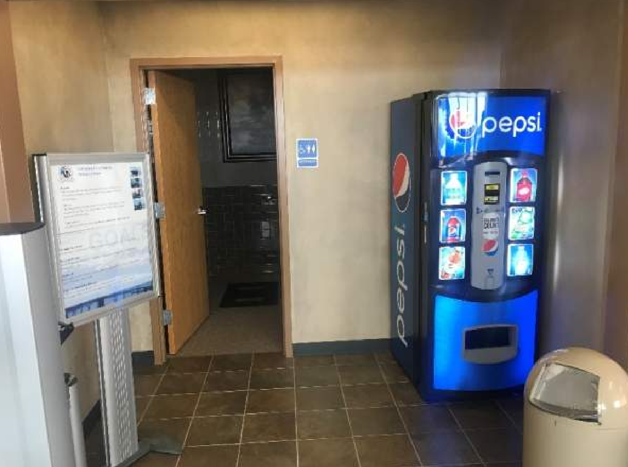
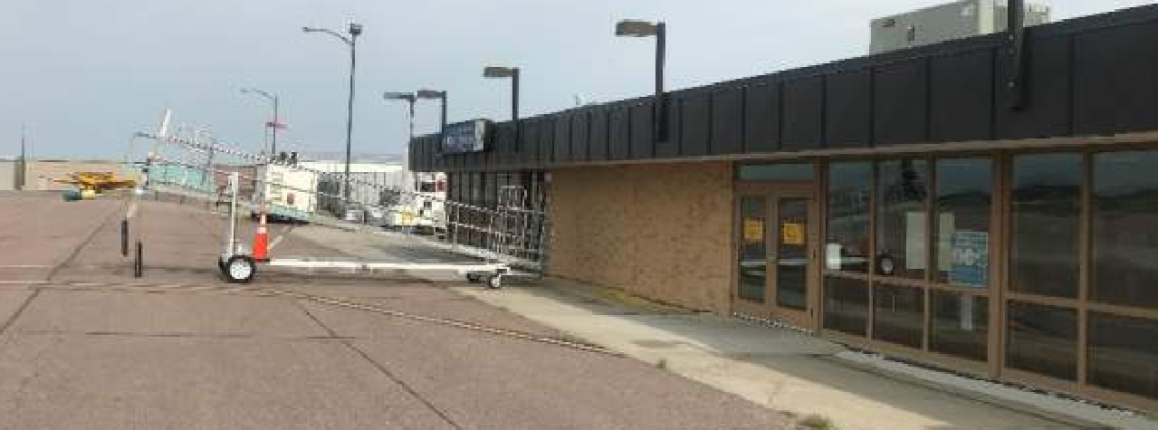
Inventory – Existing Terminal
Airside Apron, Baggage Make-up, Unisex Restroom/Private Screening Area

Slide 11
Alternatives

Slide 12
Alternatives
Site 4: Existing Loop Road Infield Area
Pros:
Utilize Existing Infrastructure
Taxlanes, Utility, Entry Drive, Parking
New Build (Phasing)
Intuitive focal point at end of entry drive
Maximizes separation from GA and Commercial Service
Cons:
Maintains existing shared entry drive with Manufacturer’s Park

Slide 13
Proposed Floor Plans

Slide 14
Proposed Floor Plans

Slide 15
ICONIC, INCREASED REGIONAL VISIBILTY

Slide 16
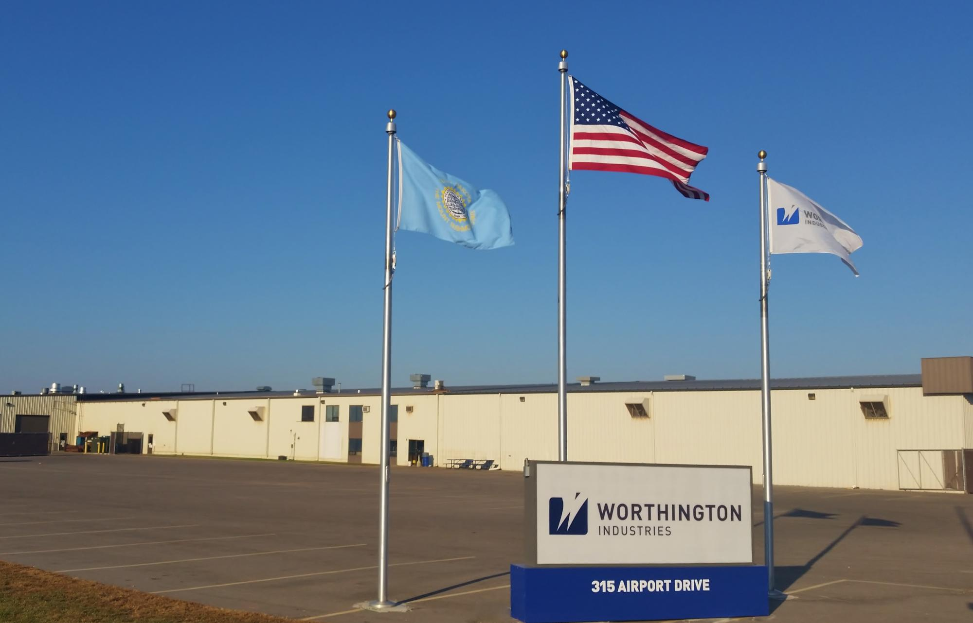
SITE CONTEXT – INDUSTRIAL MATERIALS

Slide 17
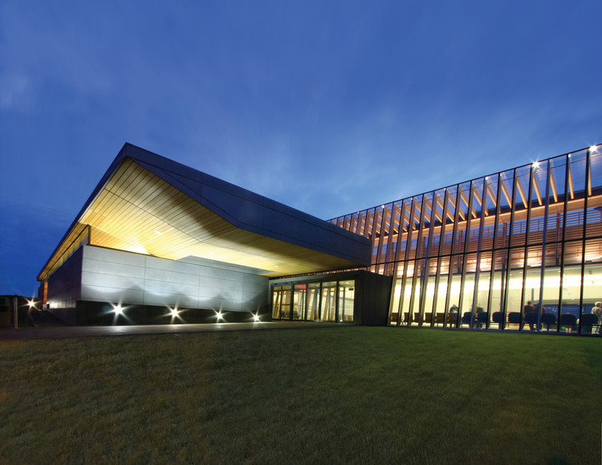
DESIGN – LIGHT & AIRY

Slide 18
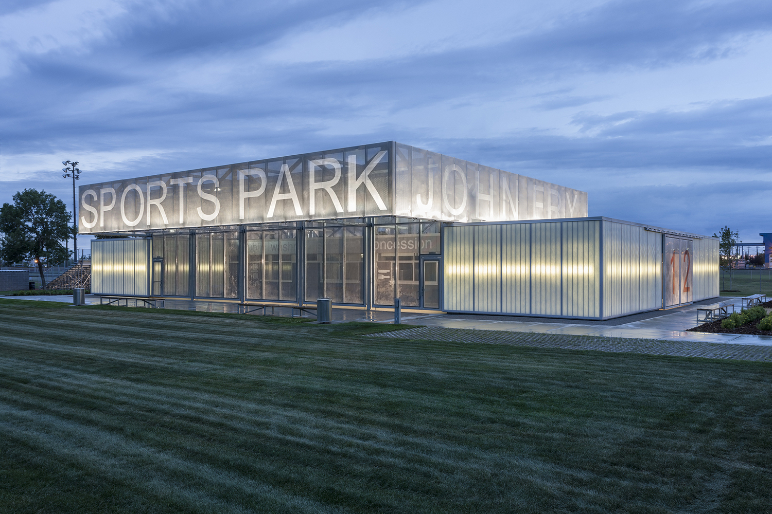
DESIGN – MARKETING OPPORTUNITY

Slide 19
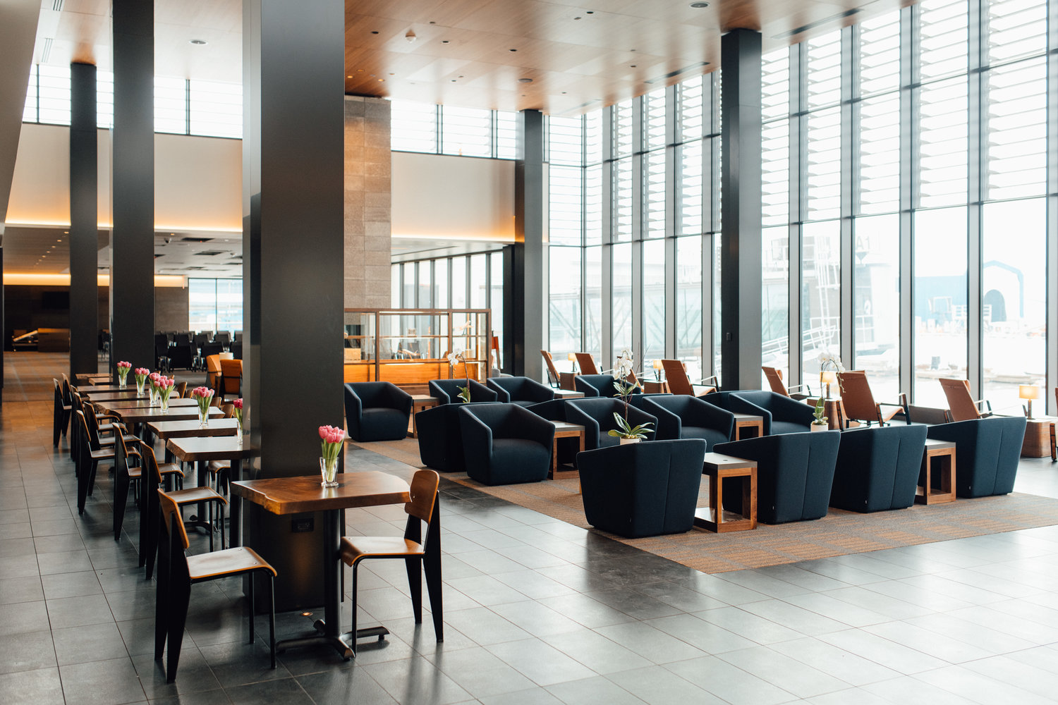
DESIGN – INVITING SPACES

Slide 20
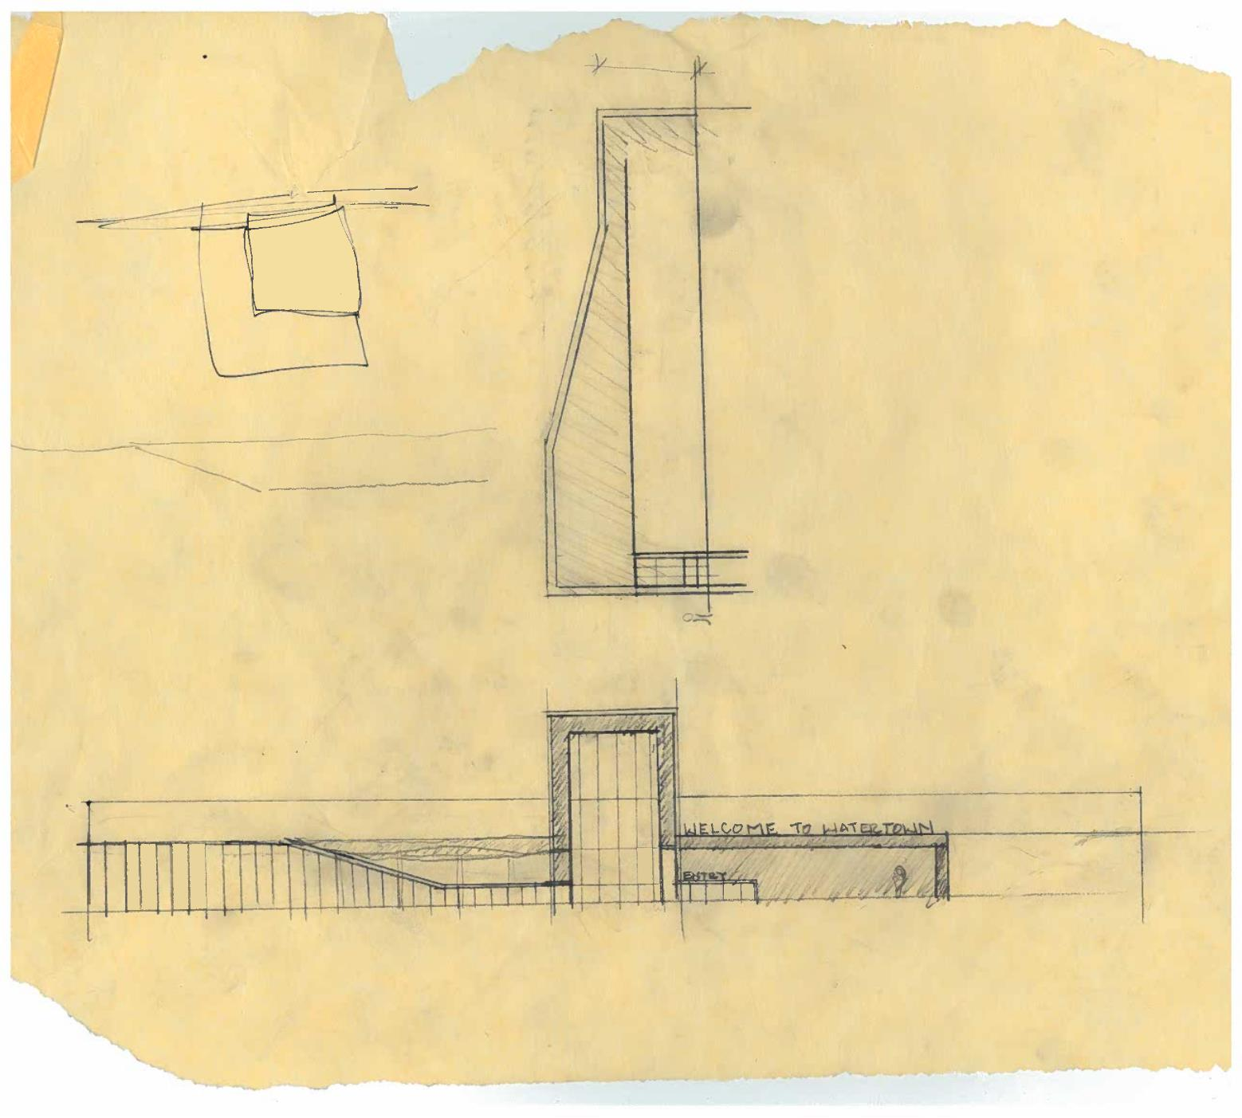
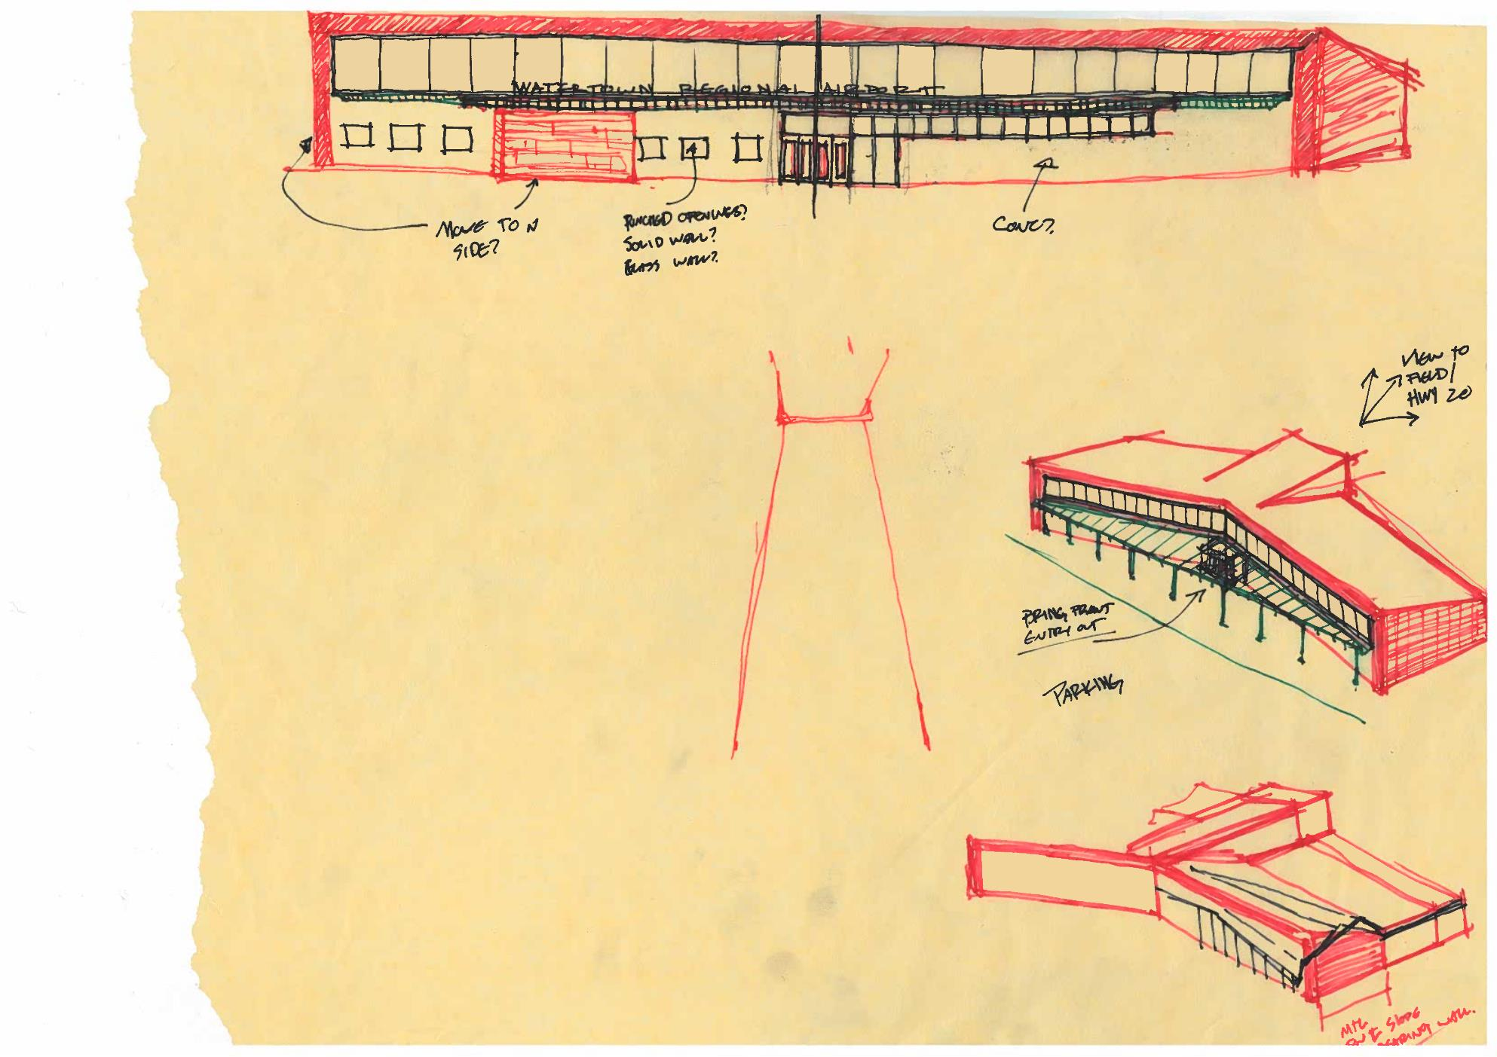
DESIGN – INITIAL CONCEPTS

Slide 21
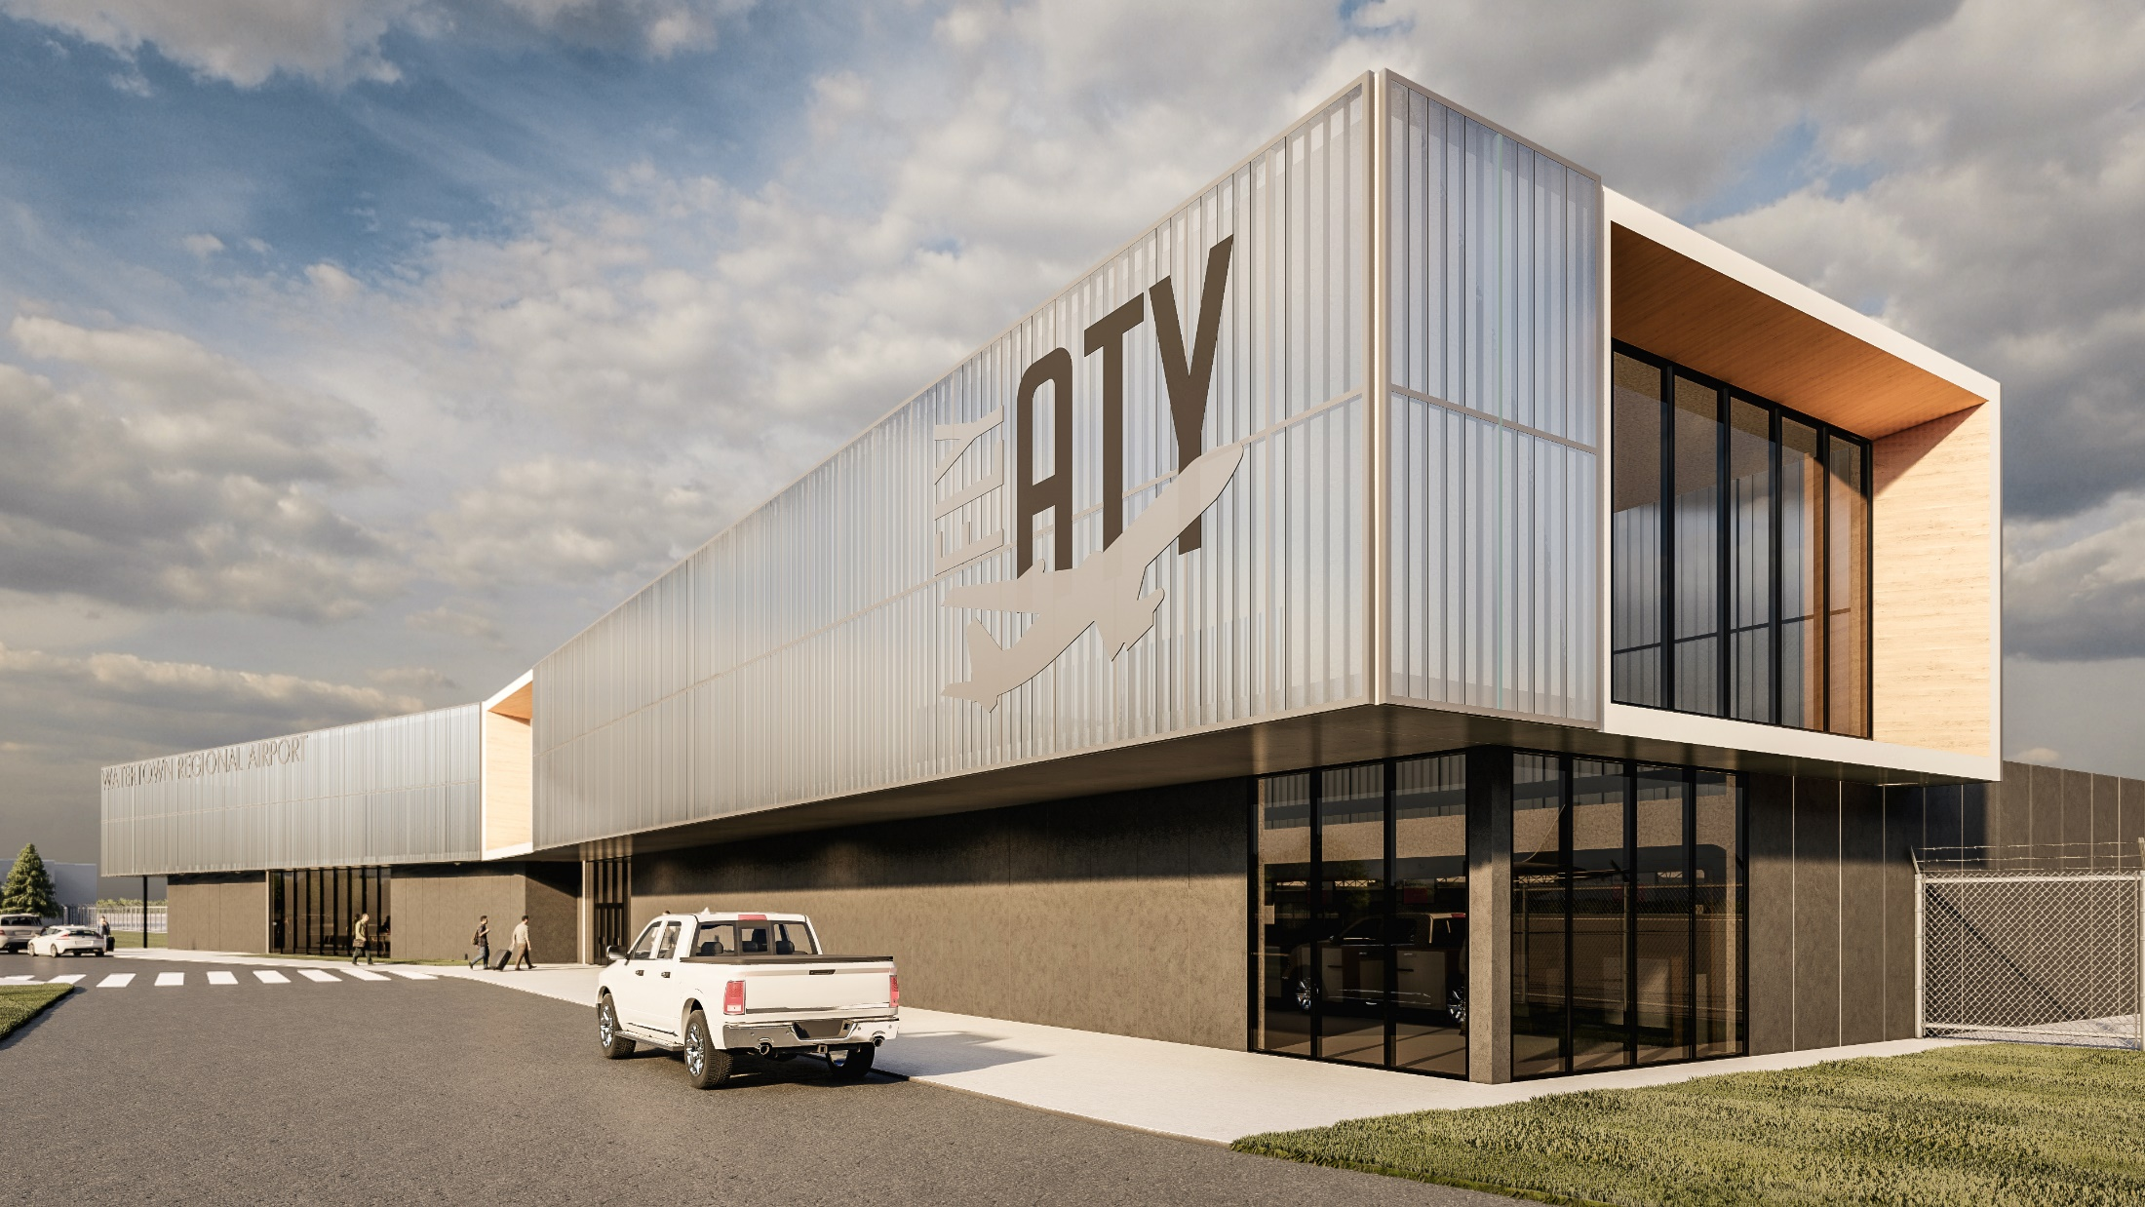
SD RENDERING

Slide 22
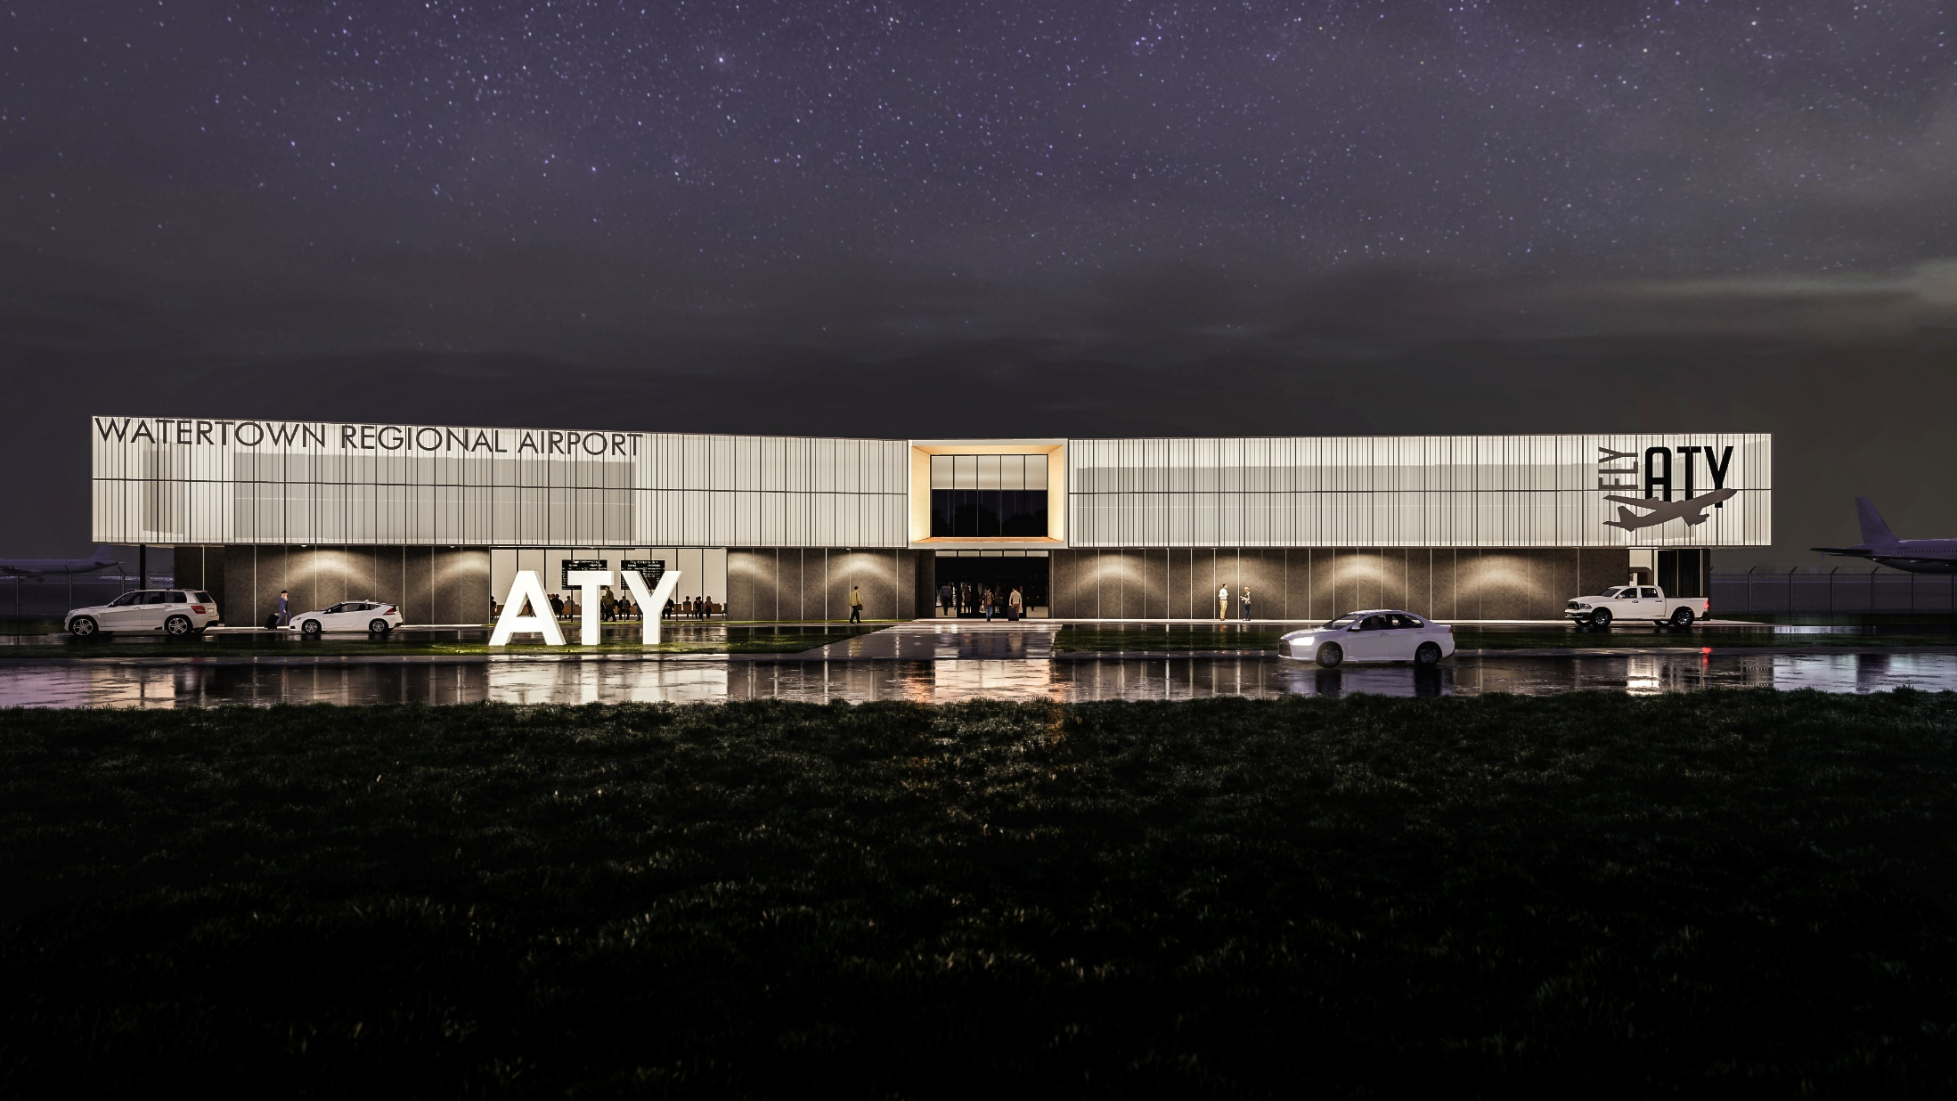
SD RENDERING

Slide 23
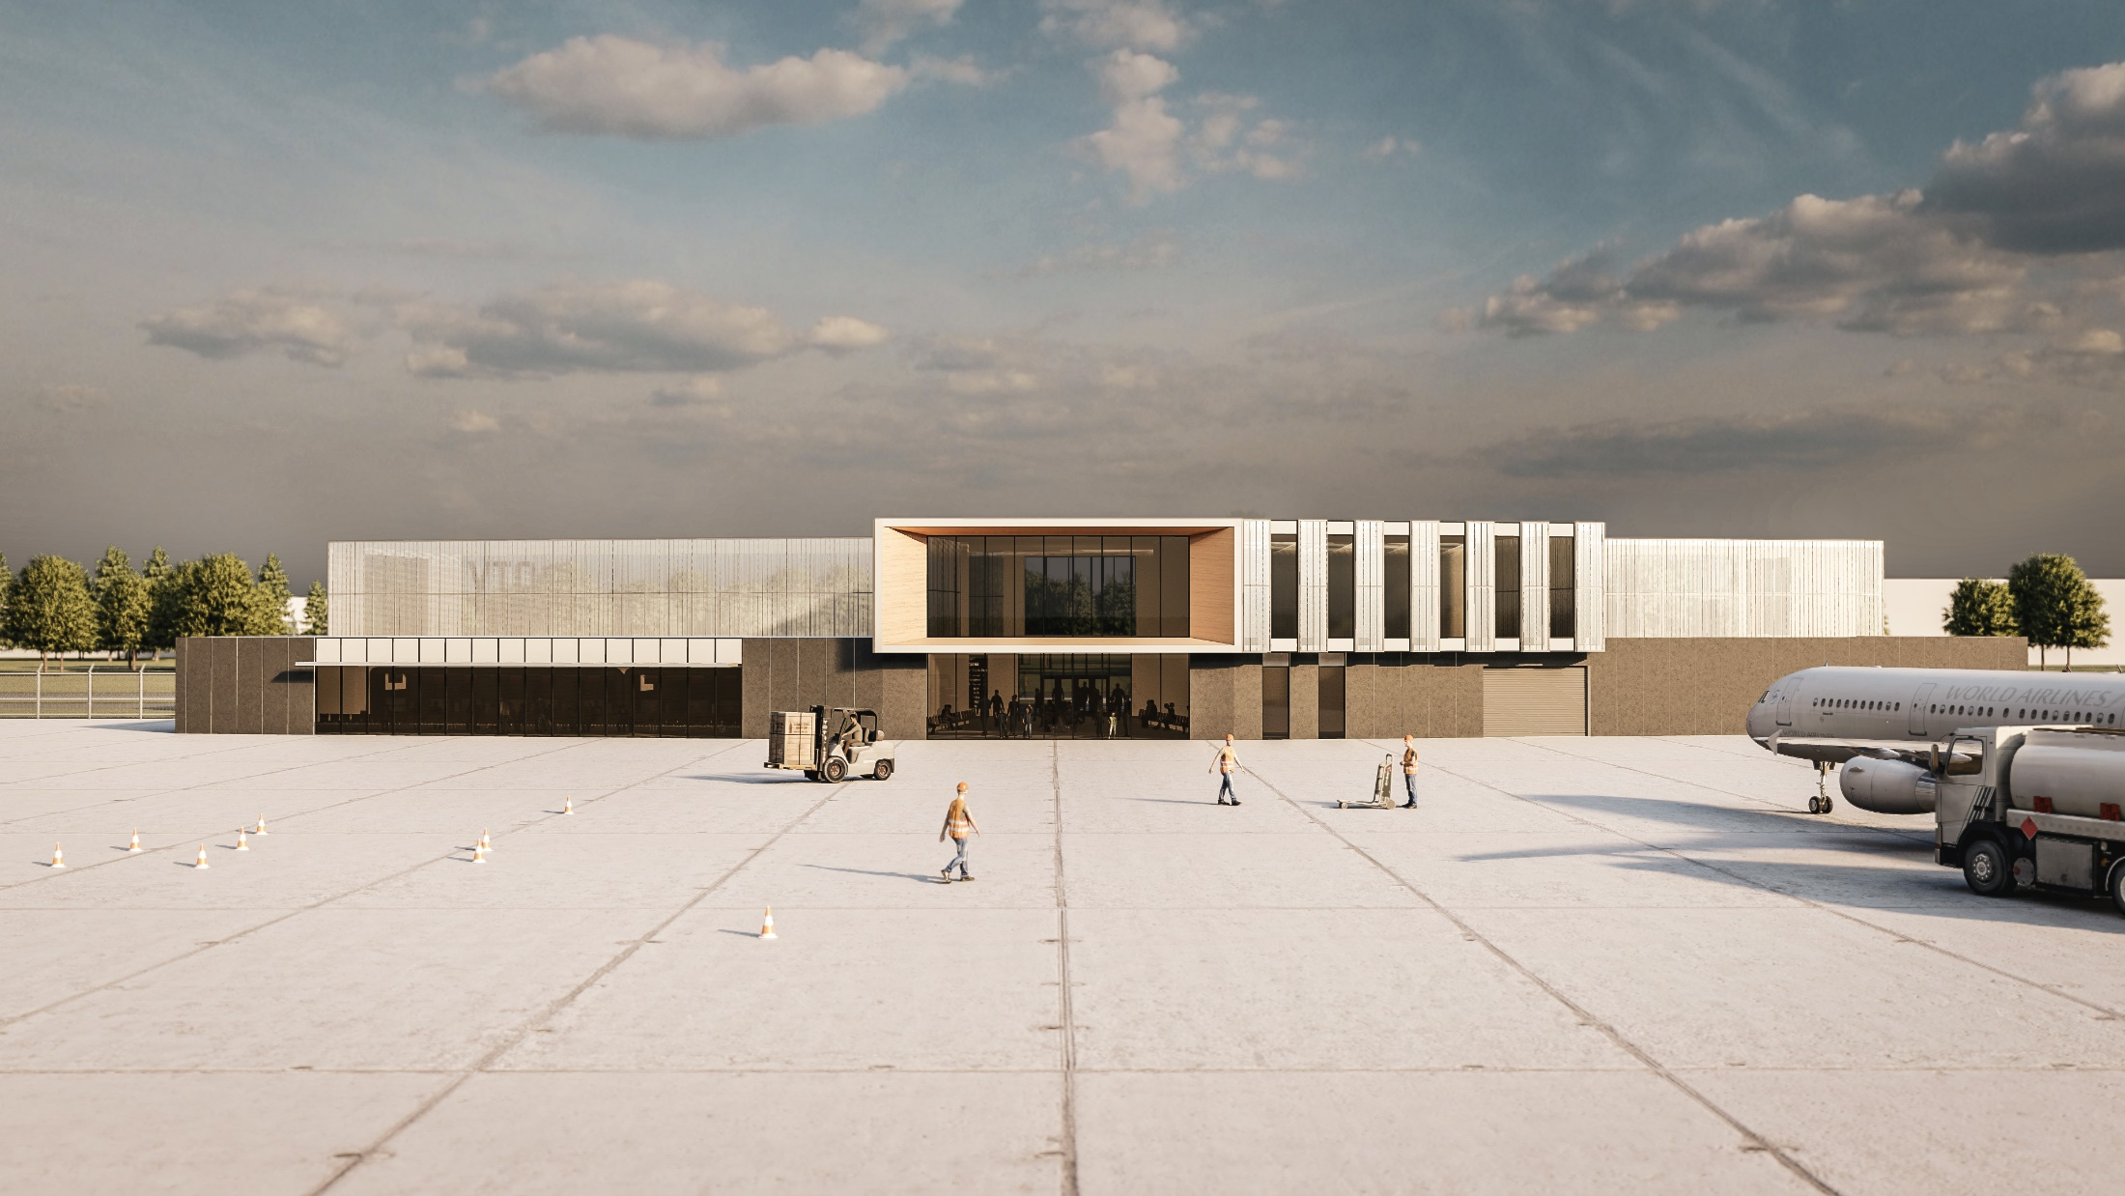
SD RENDERING

Slide 24
DESIGN DEVELOPMENT

Slide 25
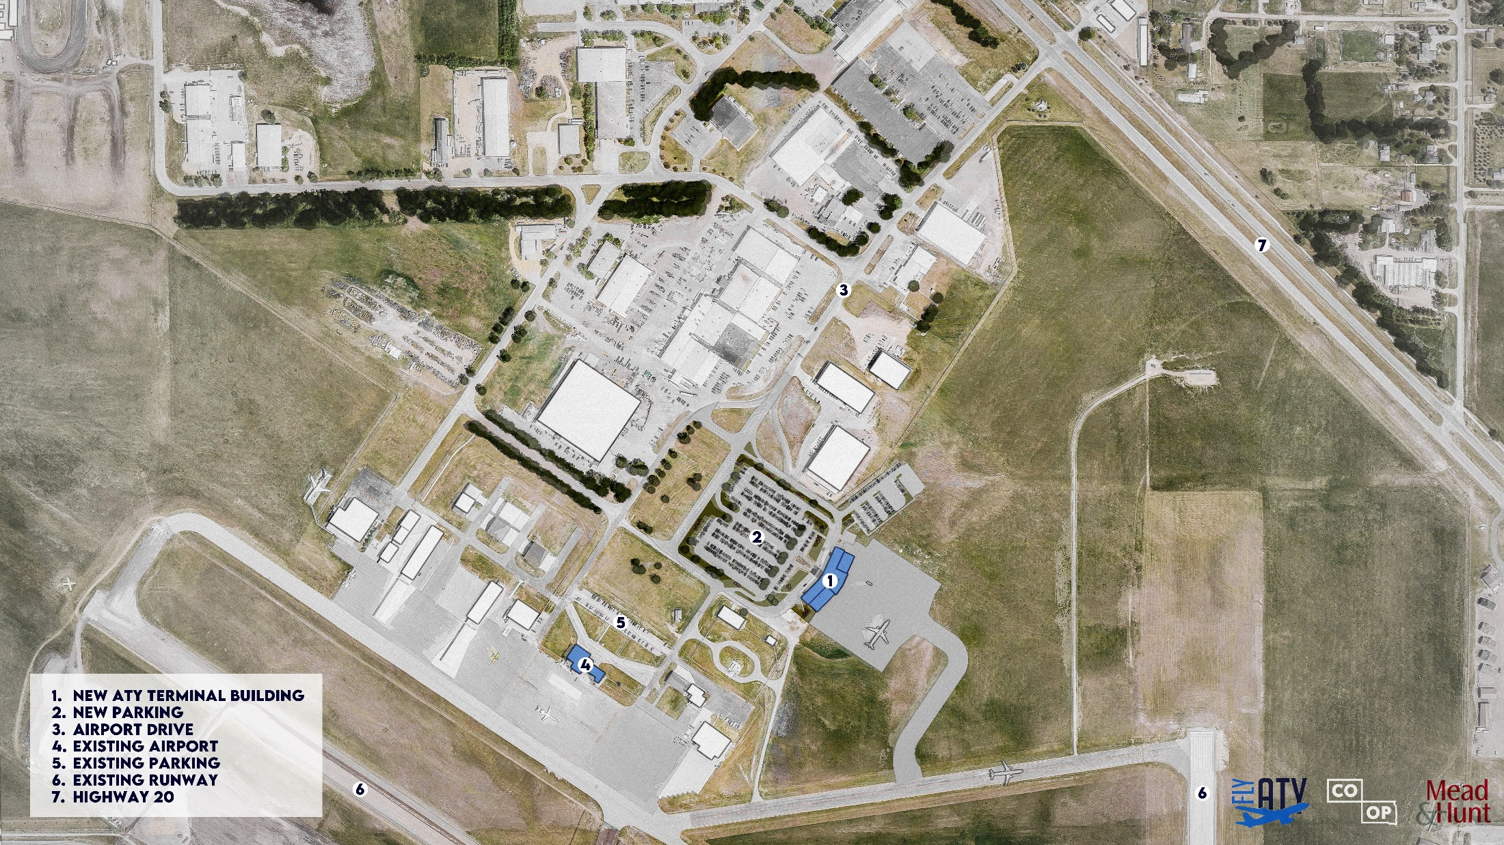
SITE PLAN

Slide 26
FLOOR PLAN

Slide 27
FLOOR PLAN

Slide 28
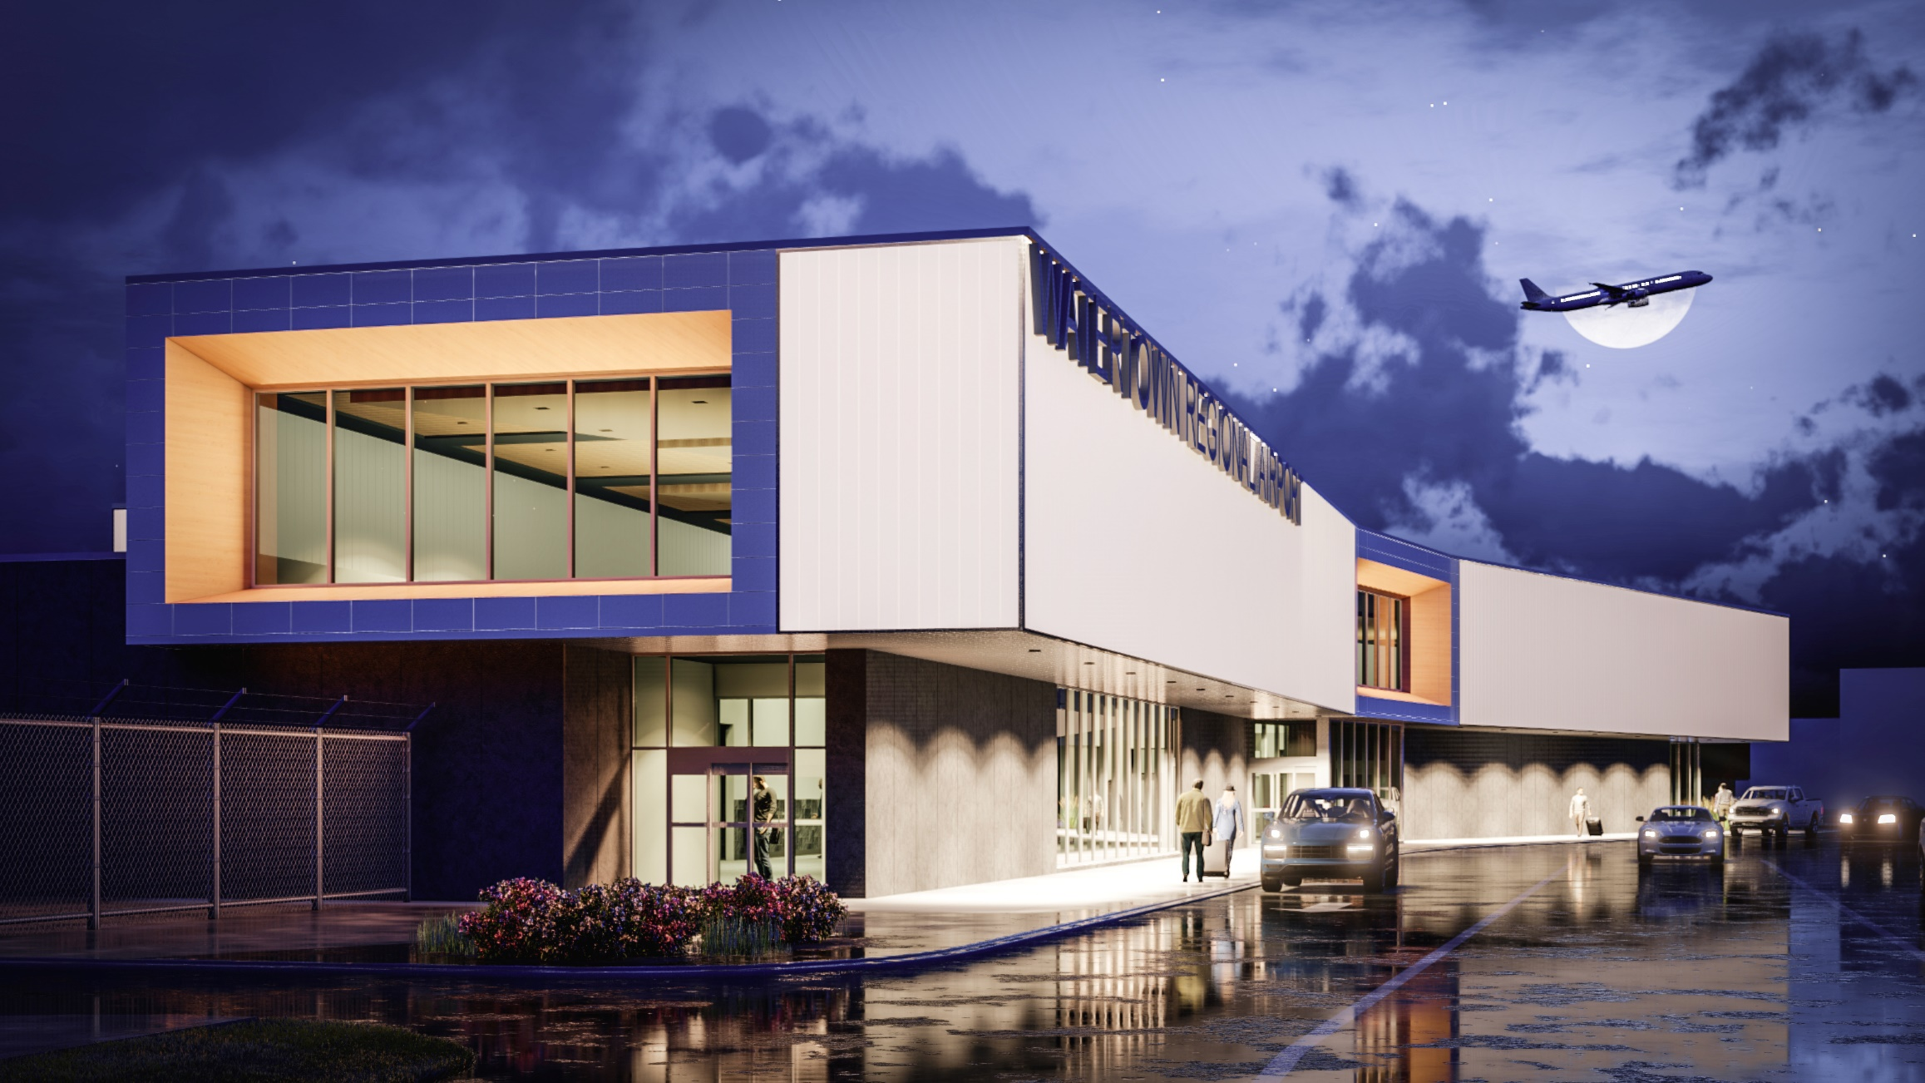
EXTERIOR RENDERING

Slide 29
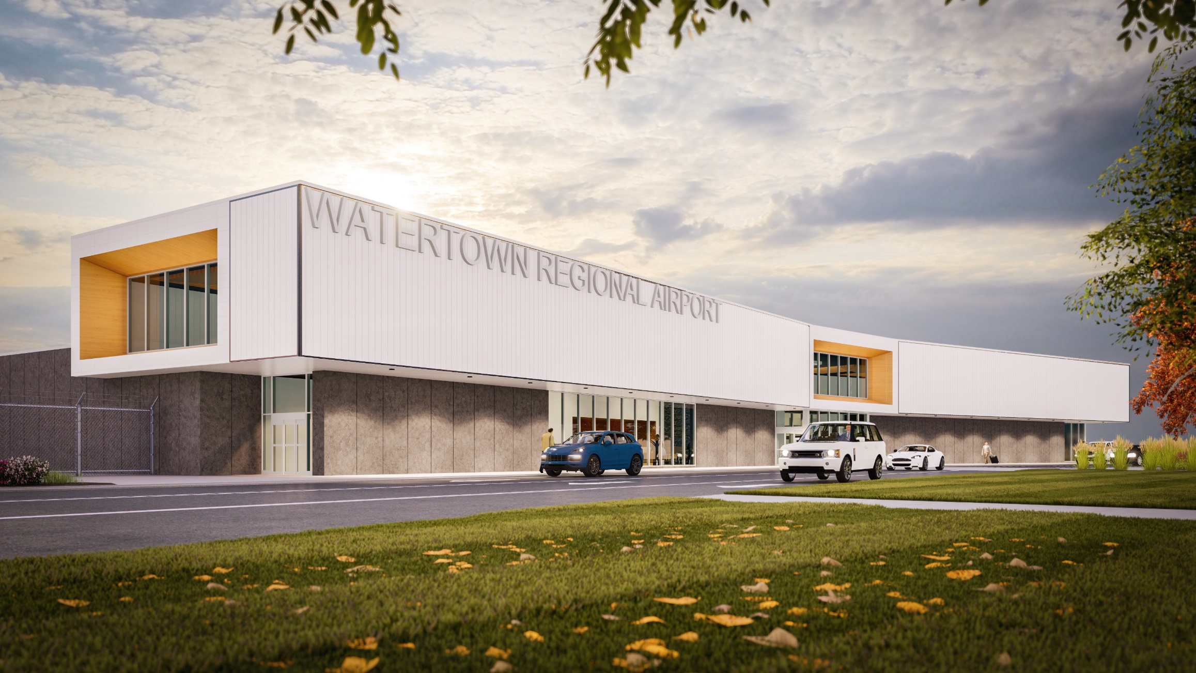
EXTERIOR RENDERING

Slide 30
EXTERIOR RENDERING

Slide 31
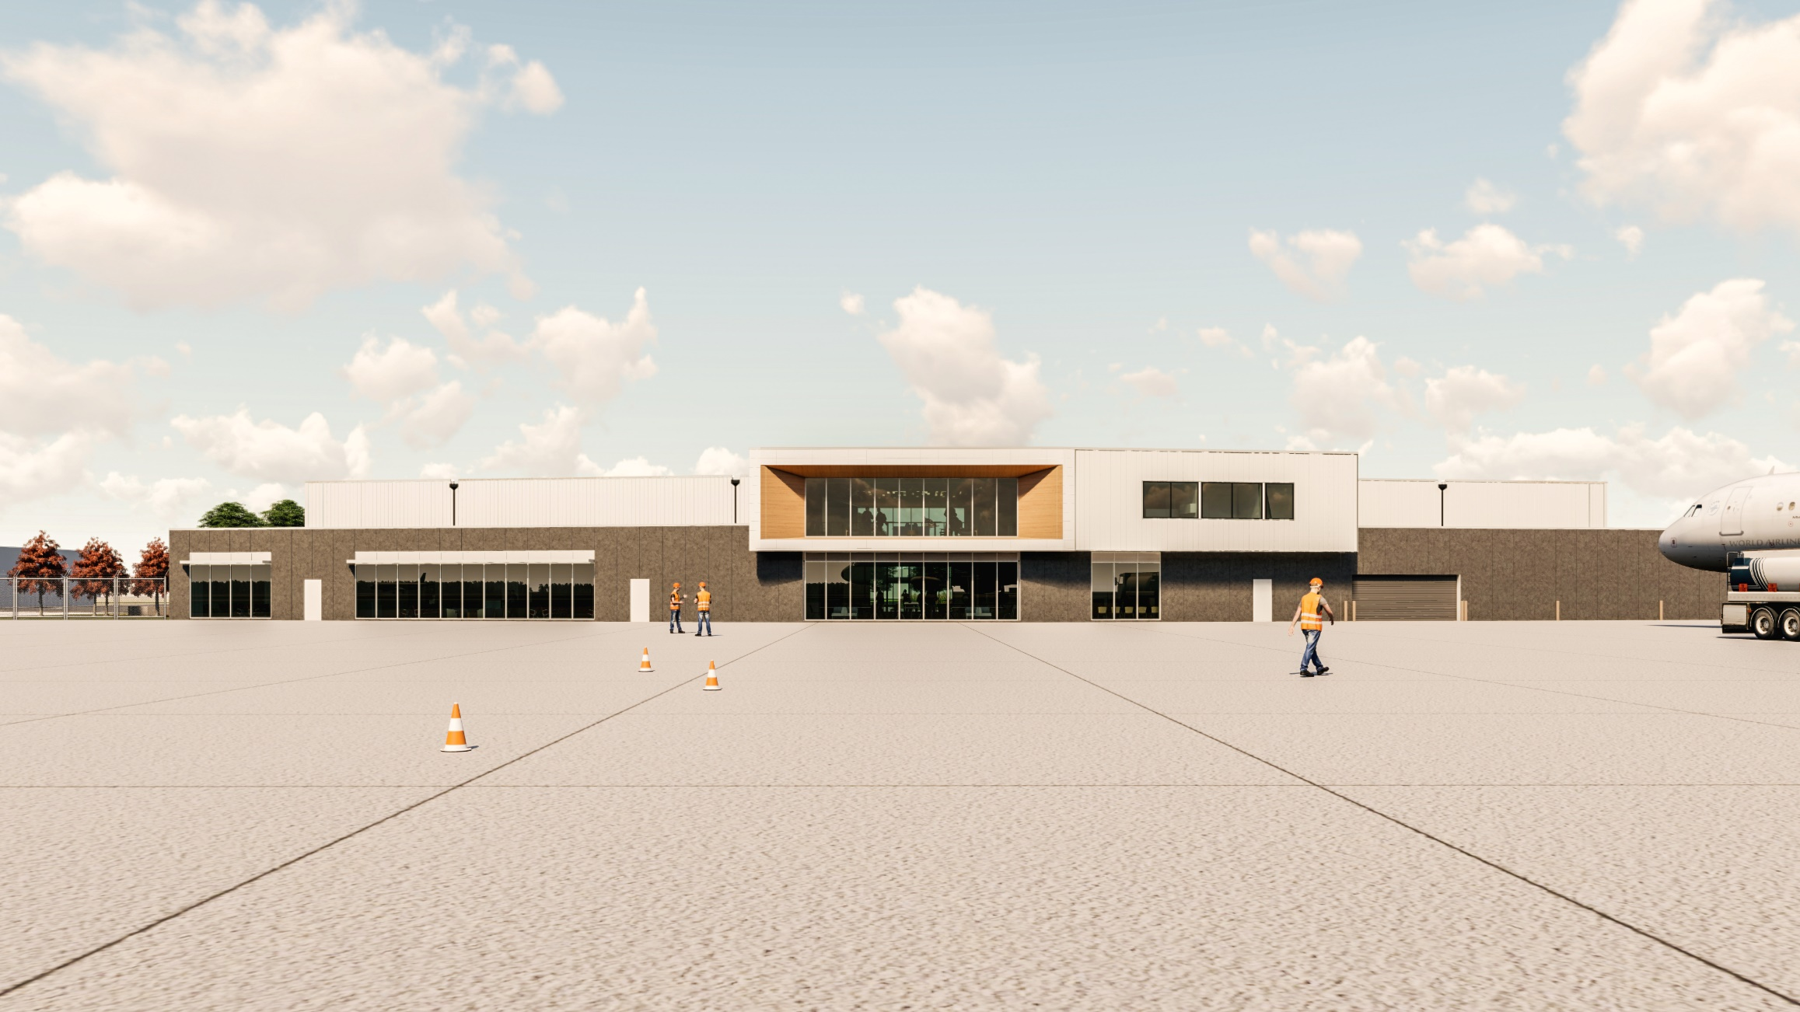
EXTERIOR RENDERING

Slide 32
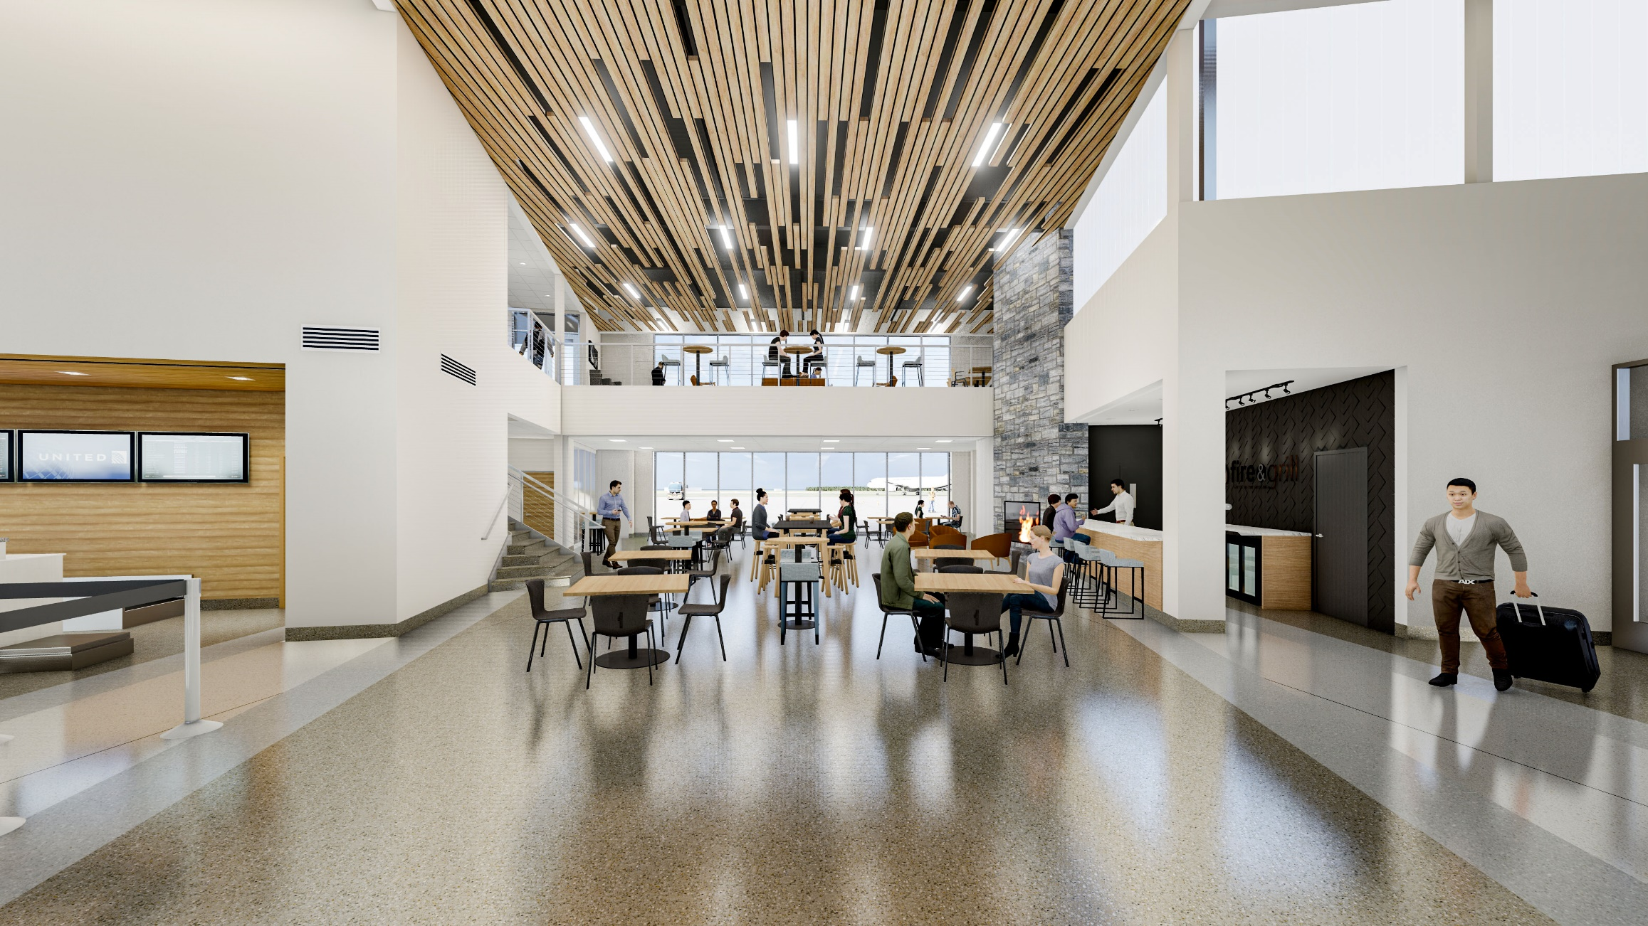
INTERIOR RENDERING

Slide 33
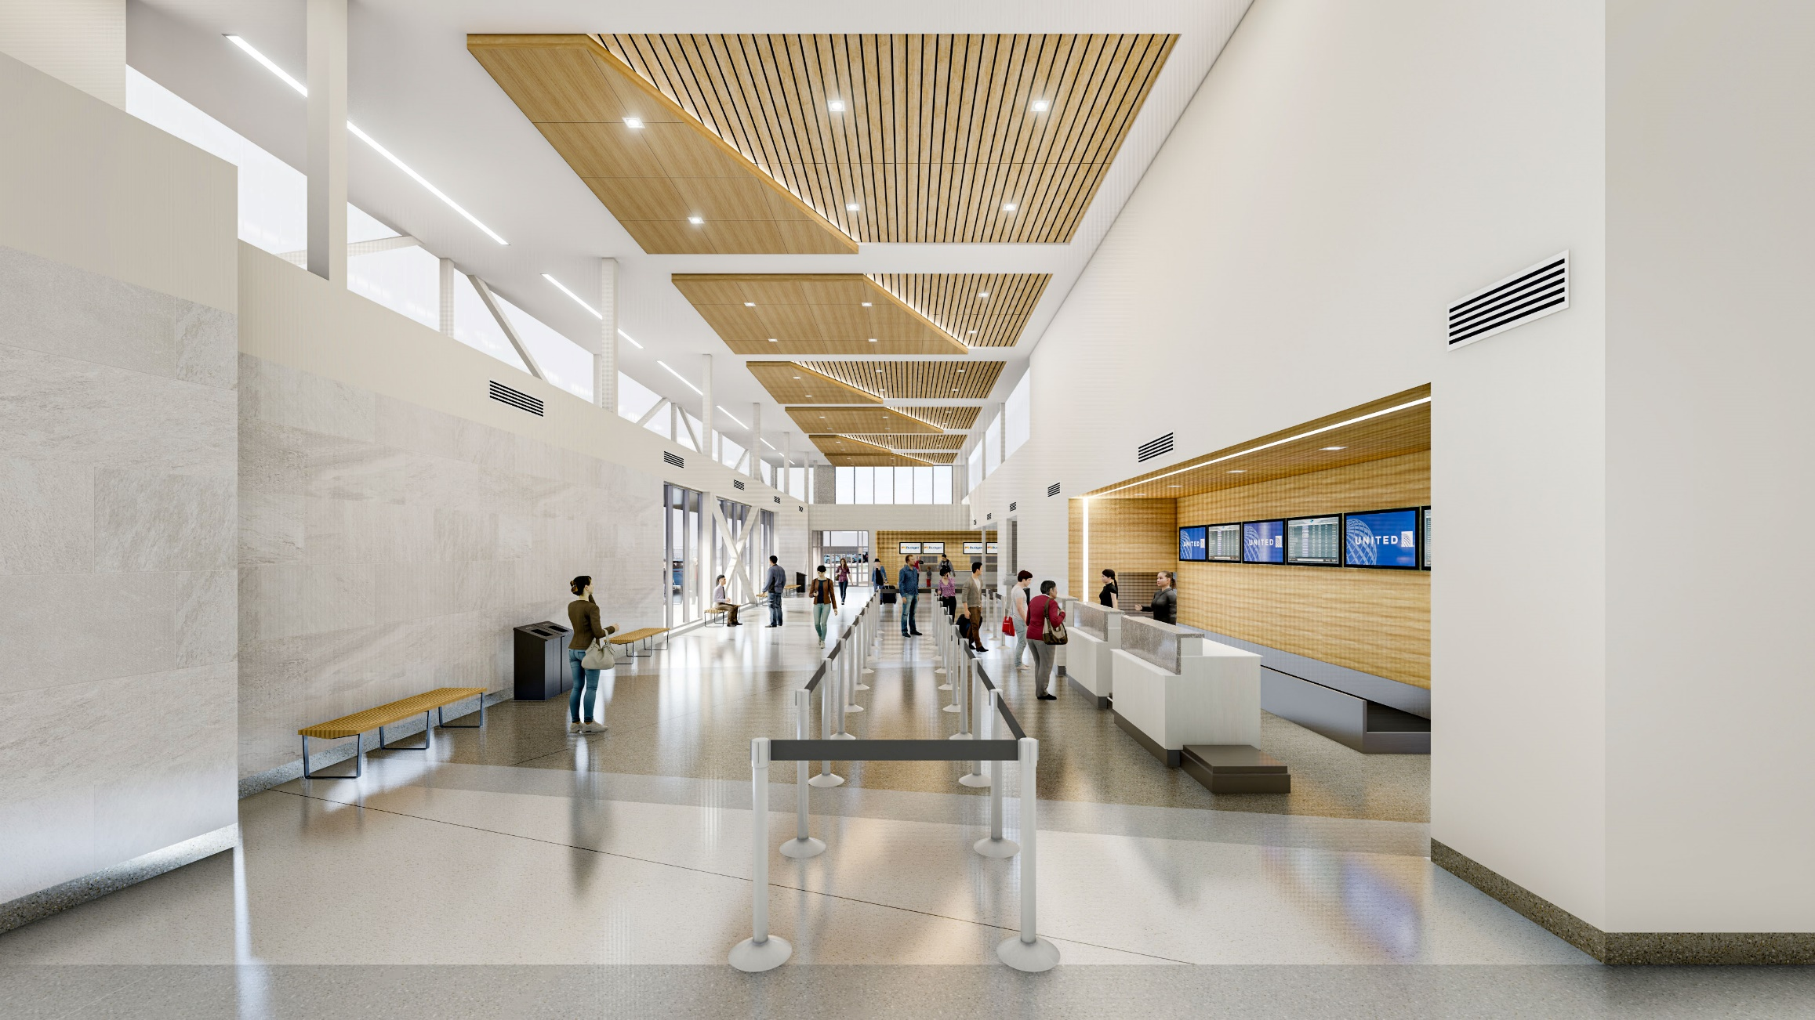
INTERIOR RENDERING

Slide 34
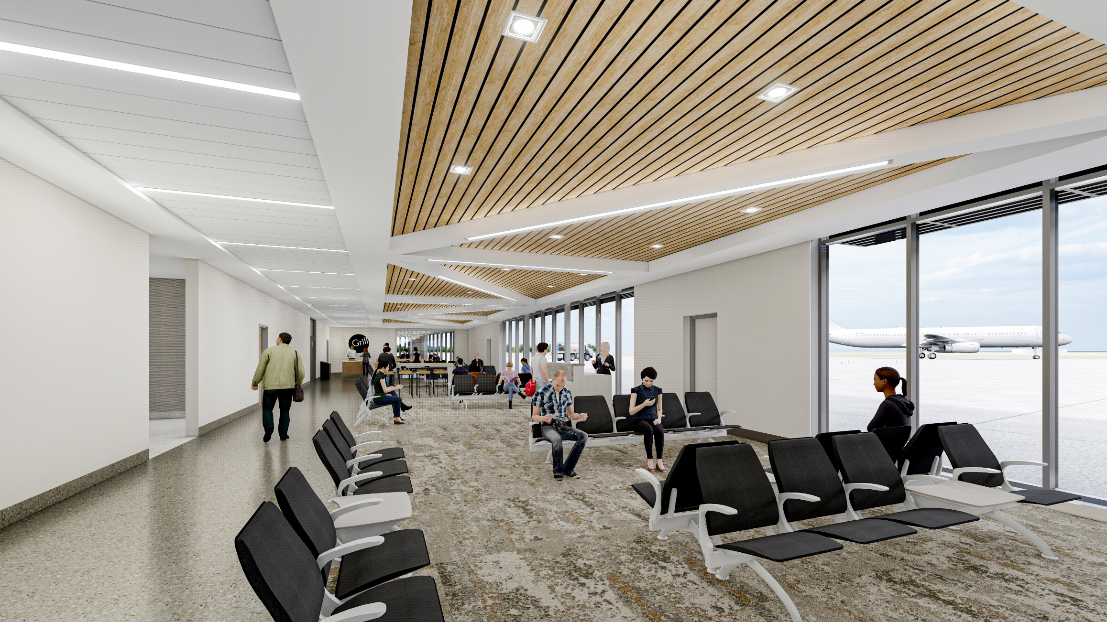
INTERIOR RENDERING

Slide 35
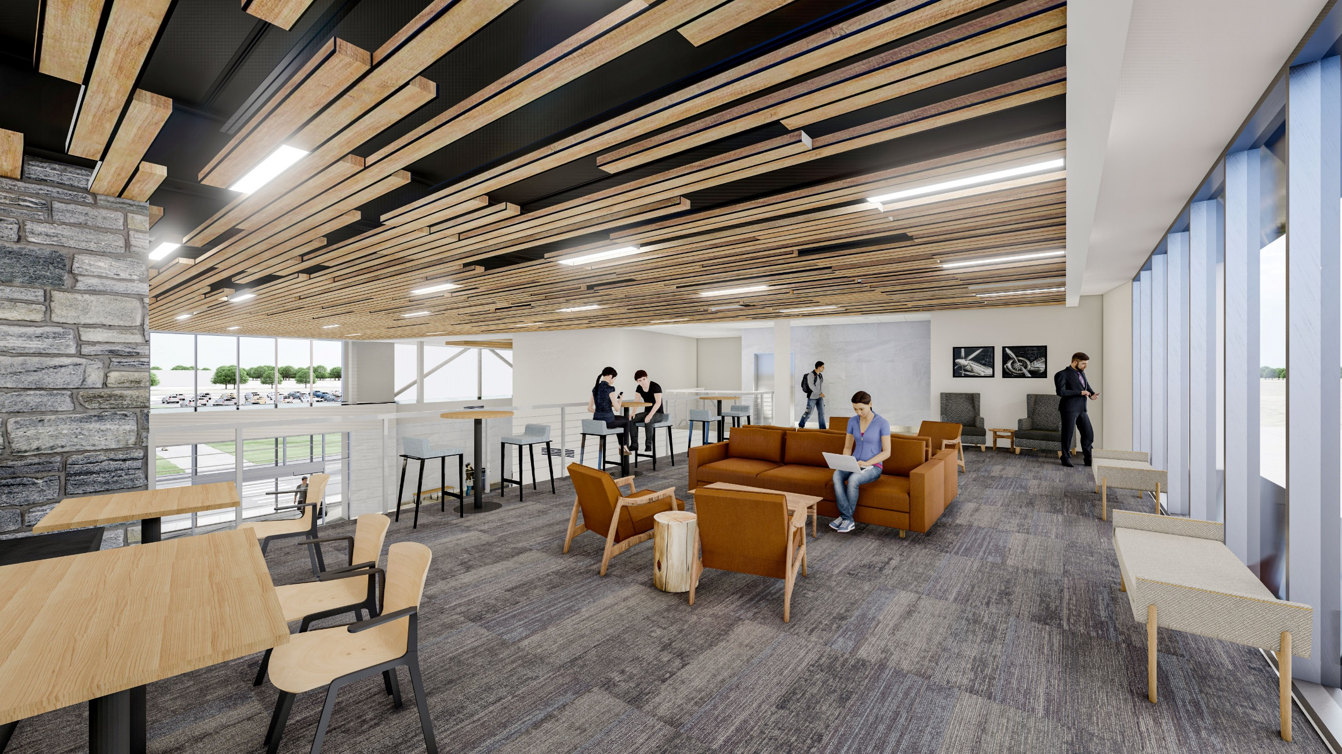
INTERIOR RENDERING

Slide 36
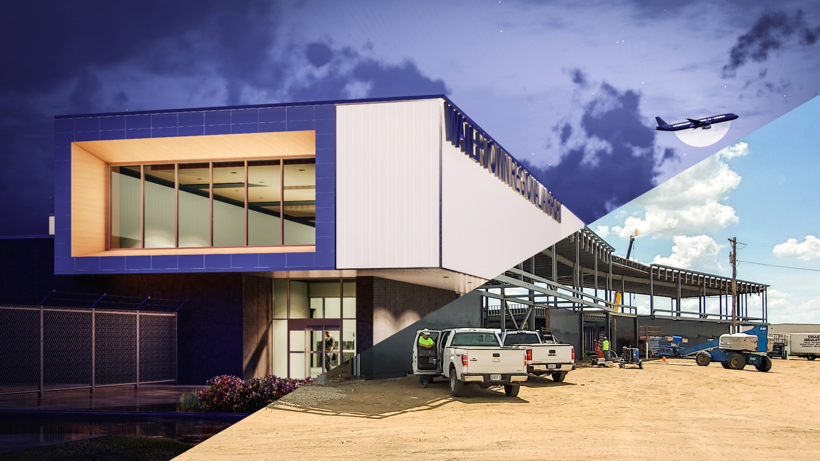
CONSTRUCTION PROGRESS

Slide 37
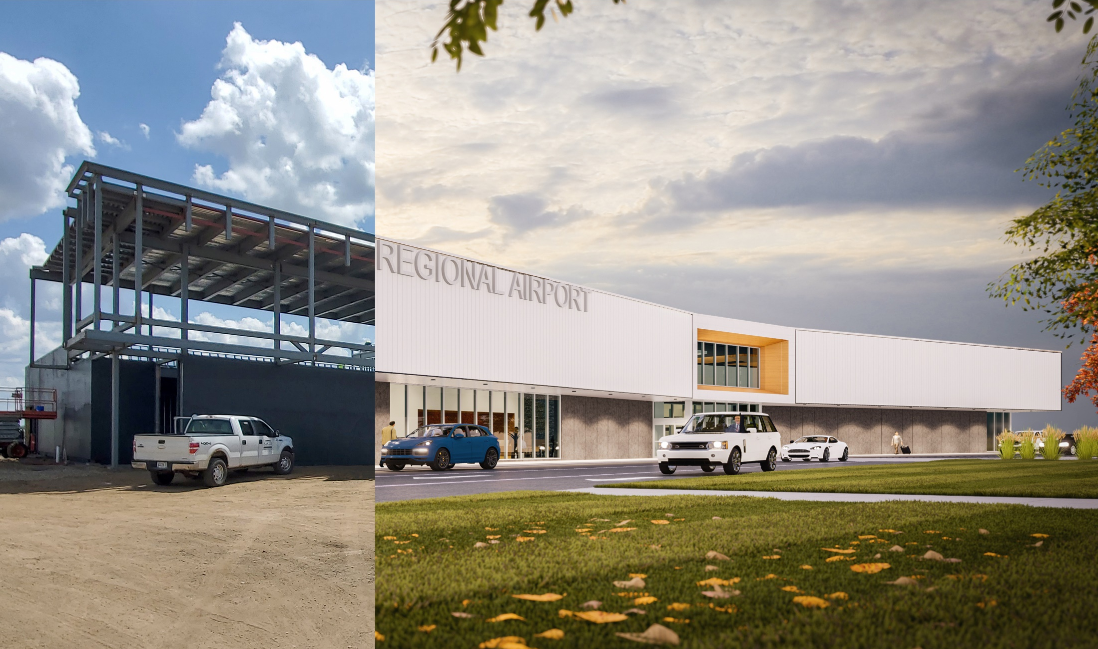
CONSTRUCTION PROGRESS

Slide 38
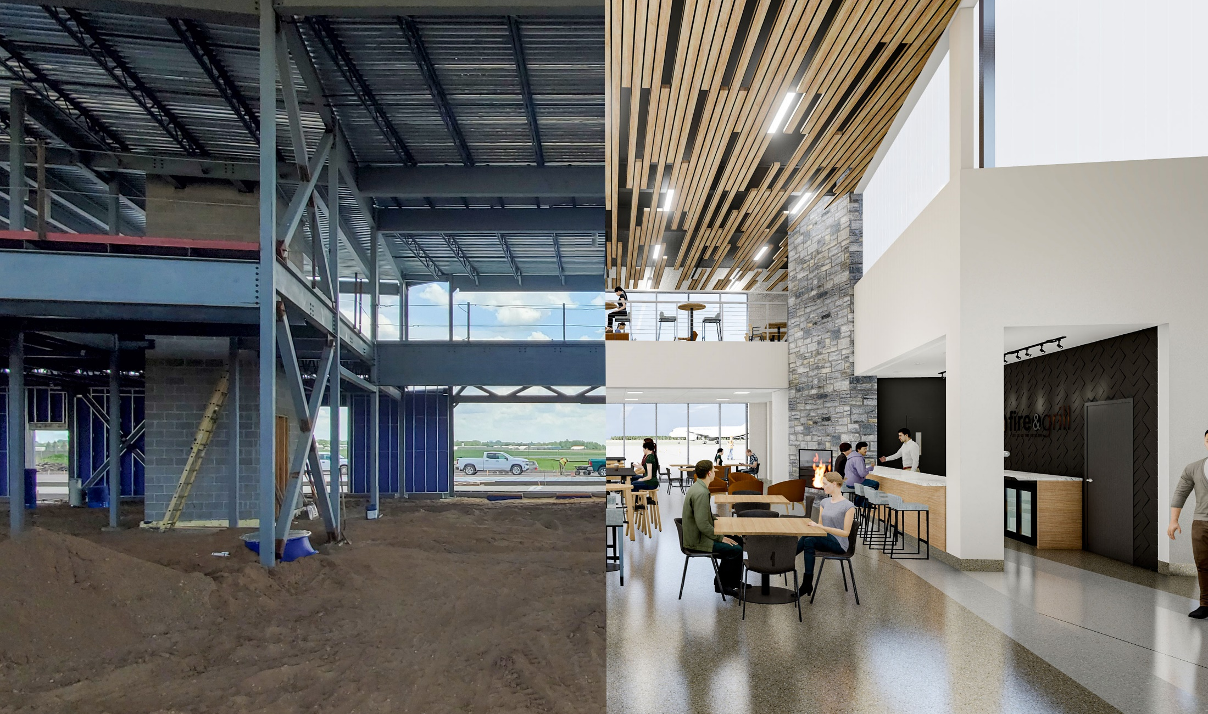
CONSTRUCTION PROGRESS

Slide 39
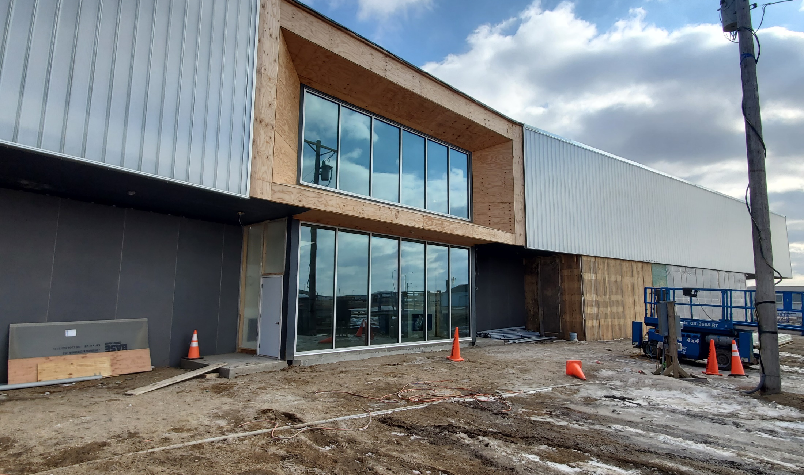
CONSTRUCTION PROGRESS

Slide 40
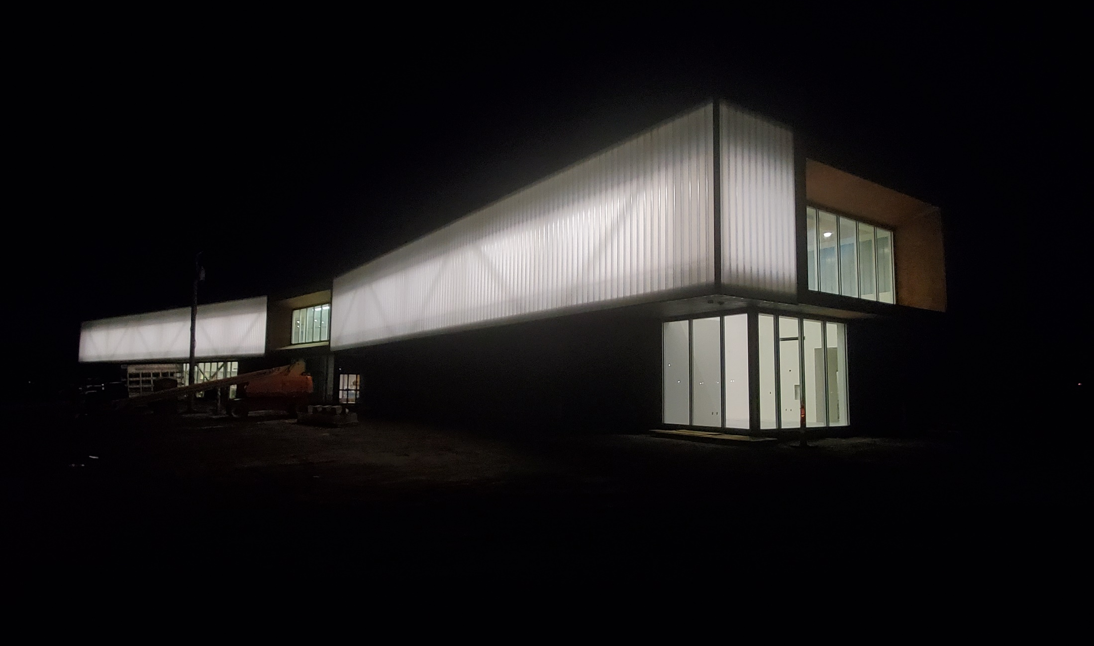
CONSTRUCTION PROGRESS

Slide 41
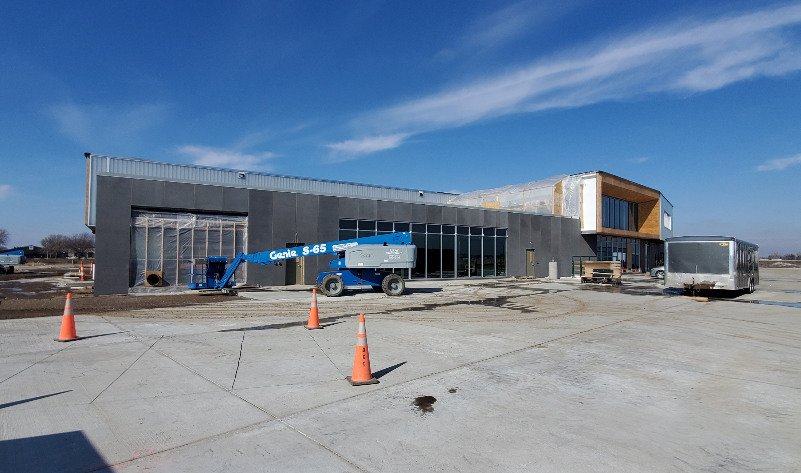
CONSTRUCTION PROGRESS

Slide 42
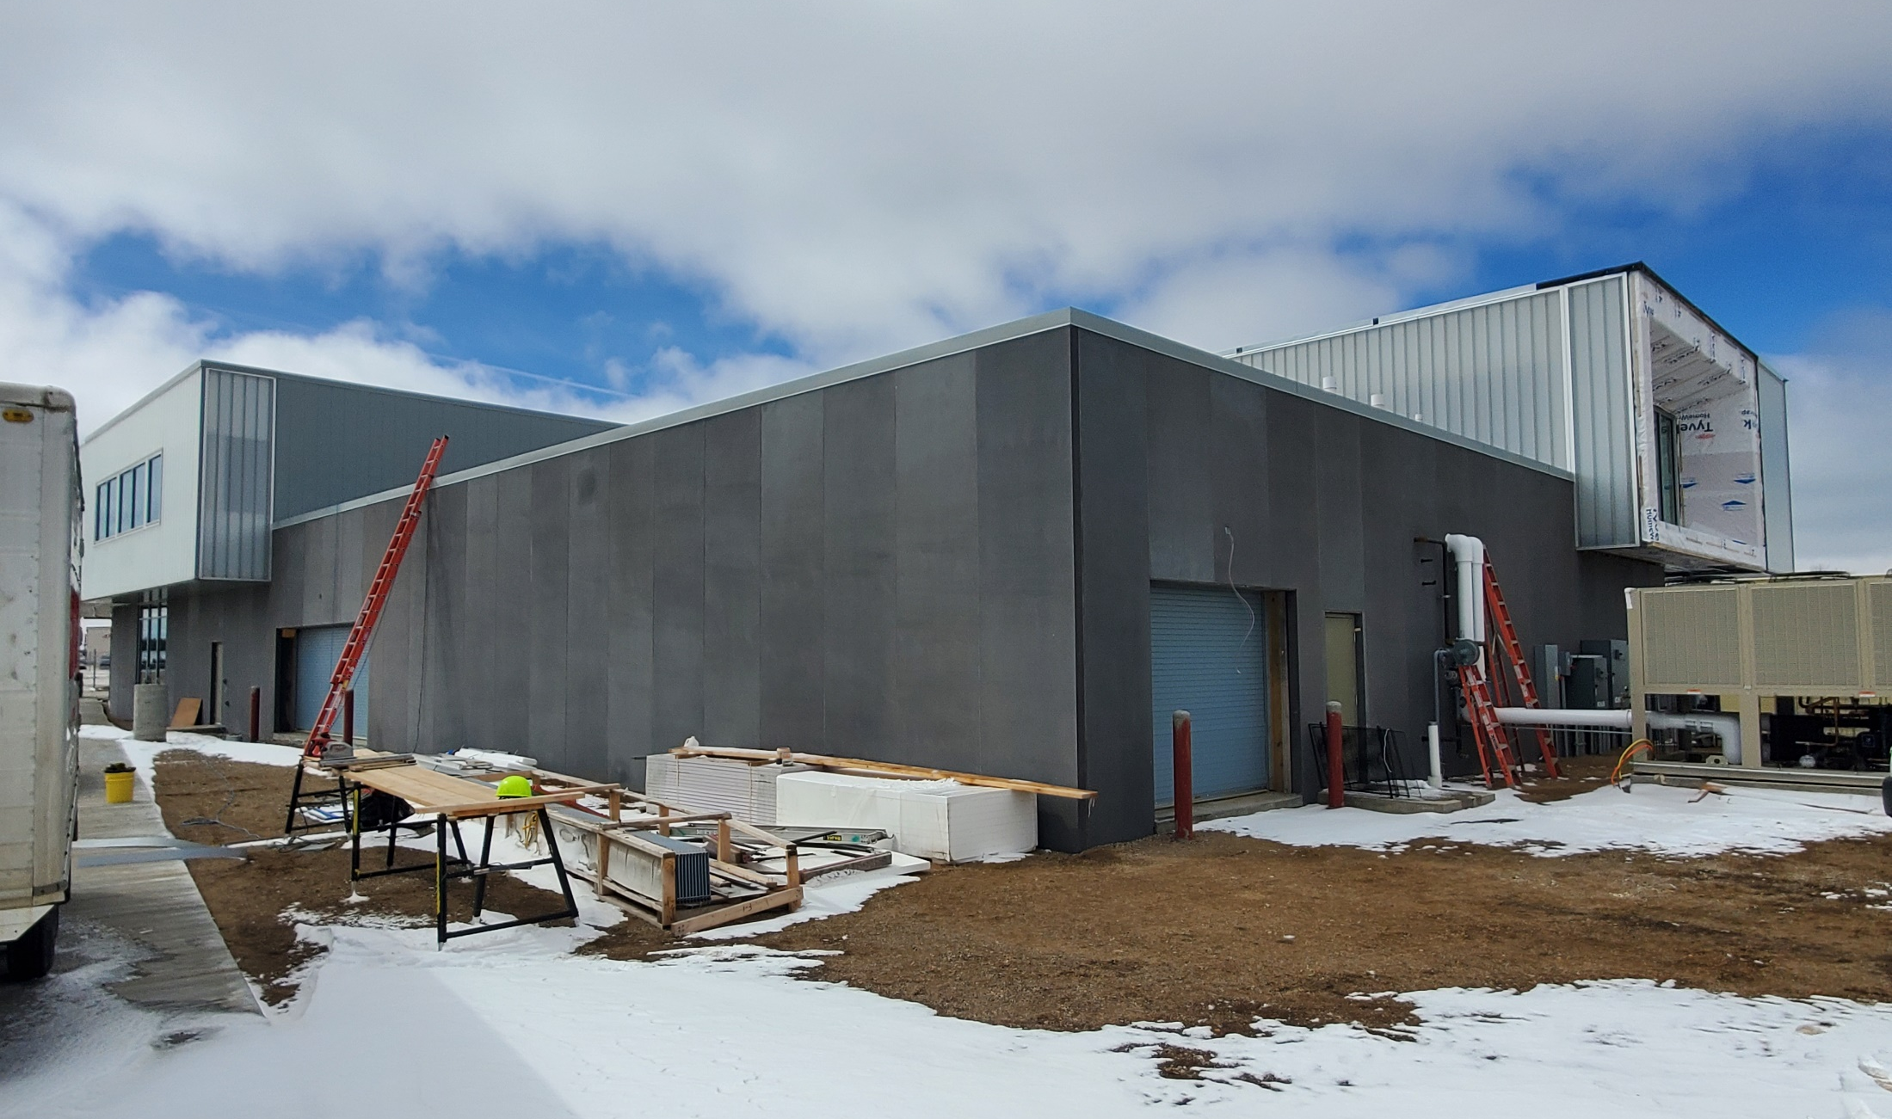
CONSTRUCTION PROGRESS

Slide 43
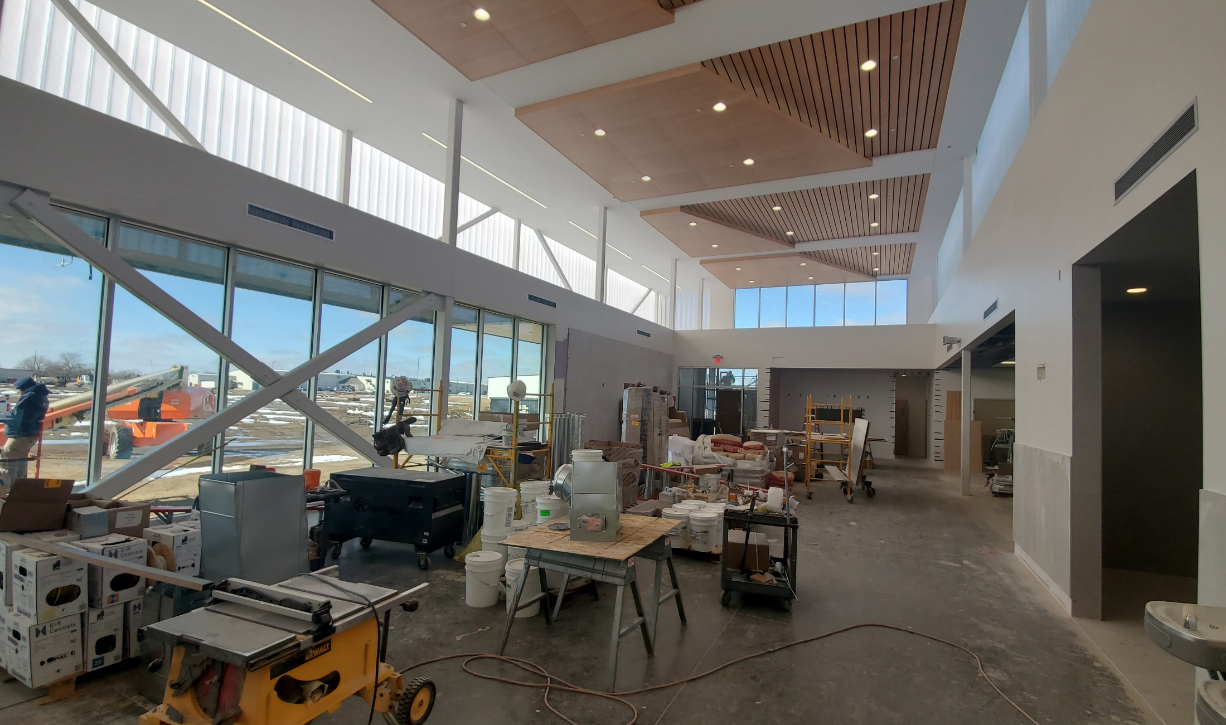
CONSTRUCTION PROGRESS

Slide 44
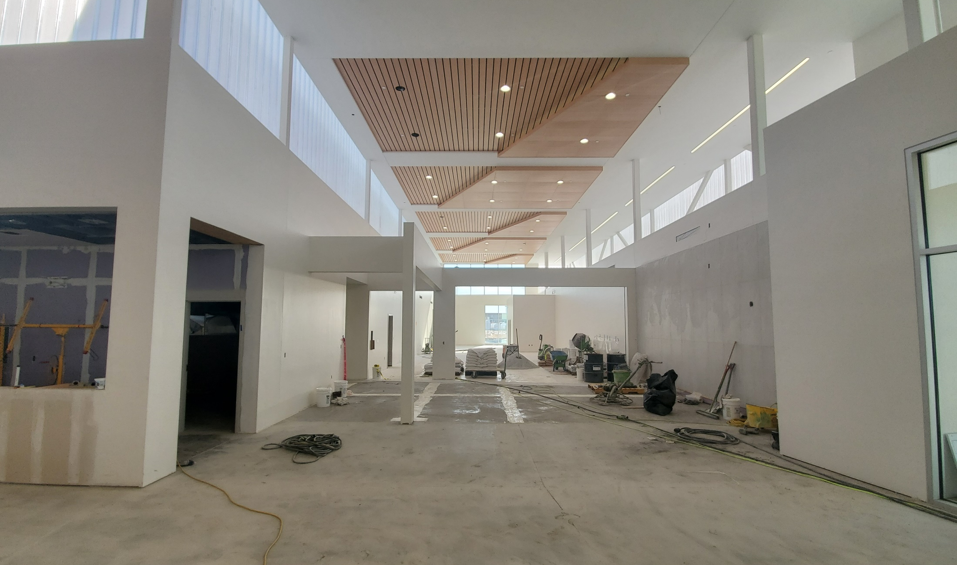
CONSTRUCTION PROGRESS

Slide 45
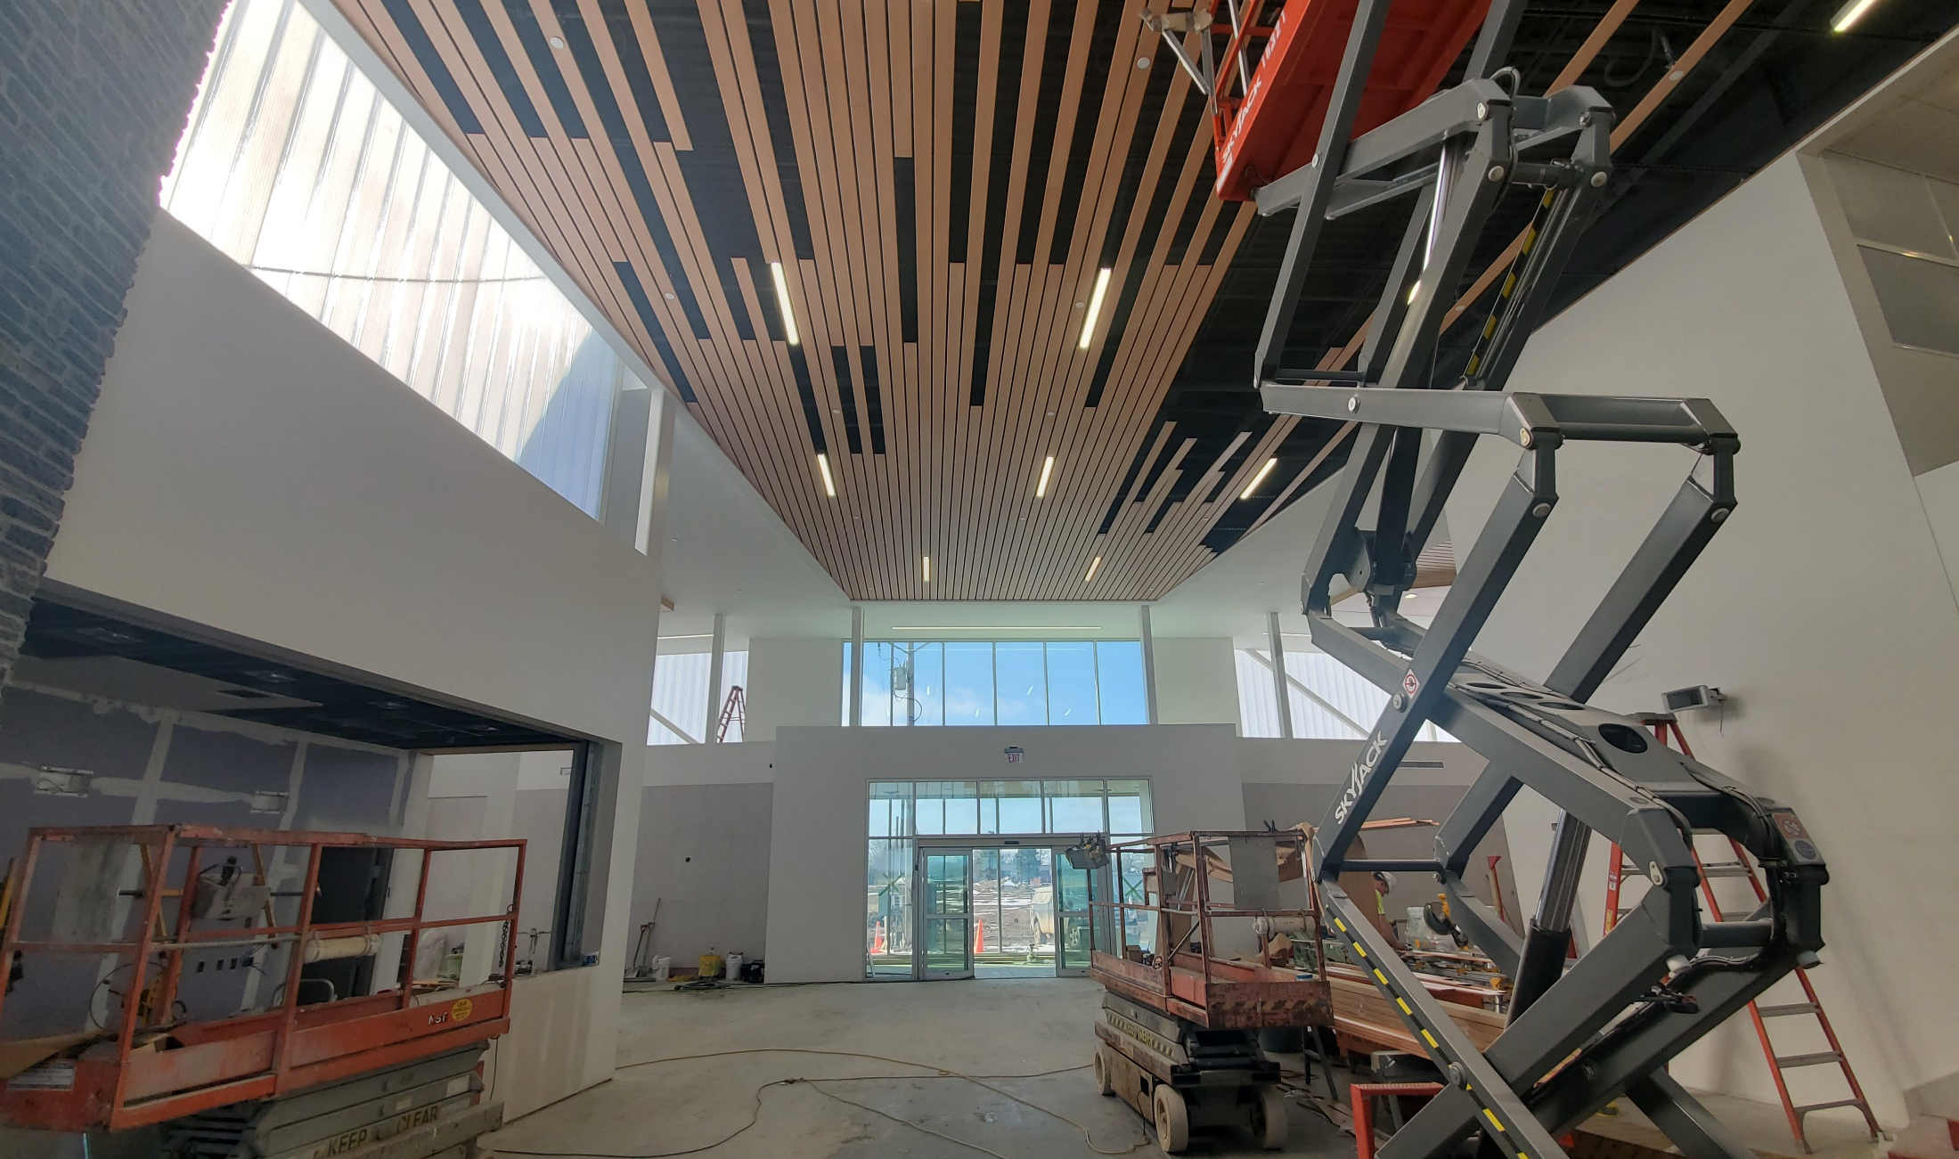
CONSTRUCTION PROGRESS

Slide 46
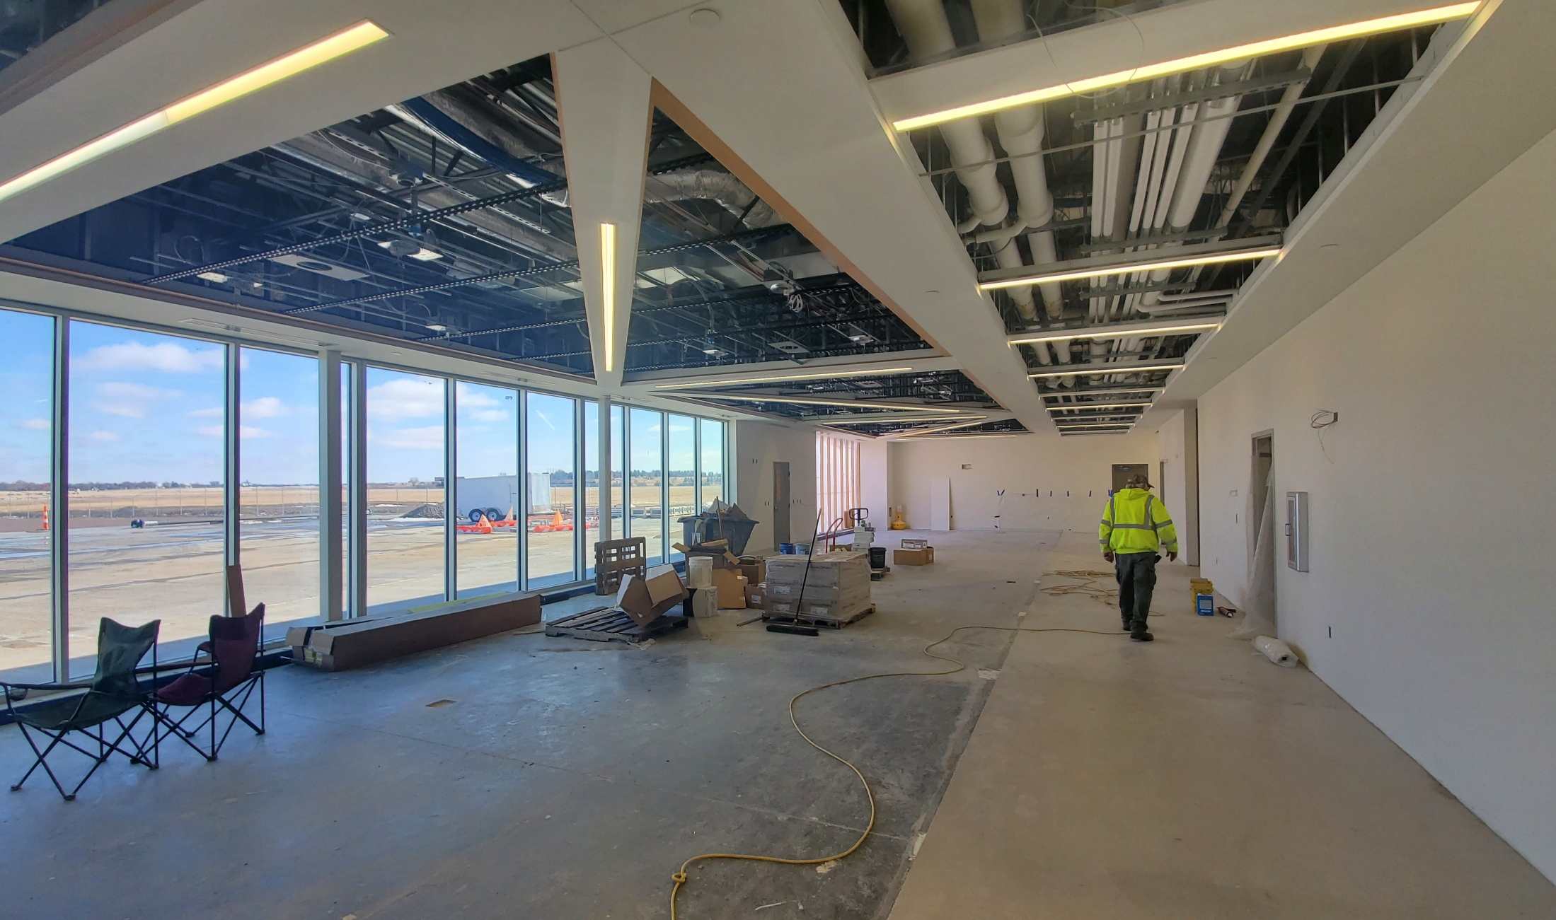
CONSTRUCTION PROGRESS

Slide 47
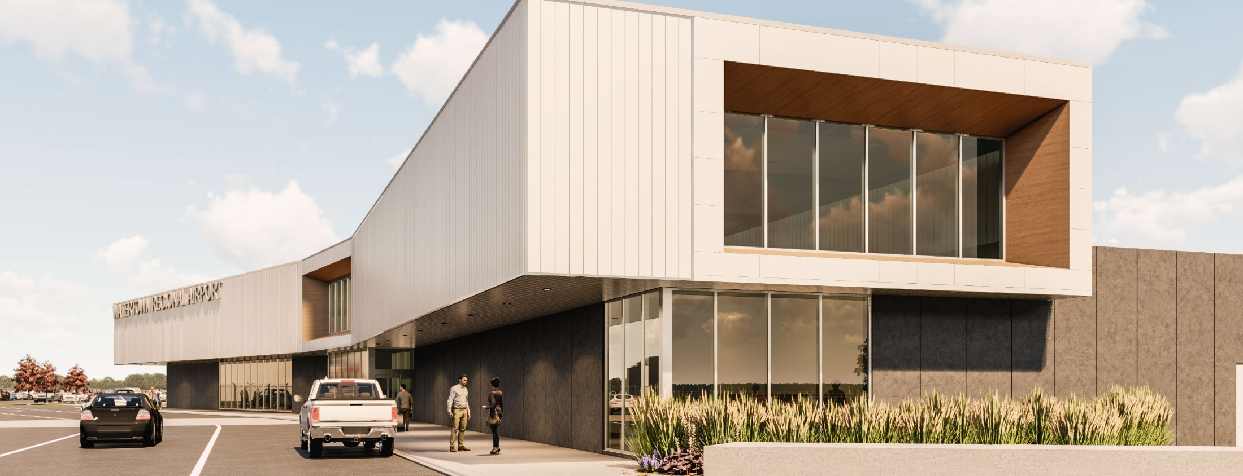
Questions & Discussion
Watertown Regional Airport
Rich Maag
Airport Manager
Phone: 605-882-6209

